Slide 1
Modularizing B+-trees: Three-Level B+-trees Work Fine
Shigero Sasaki* and Takuya Araki
NEC Corporation
*currently with 1st Nexpire Inc.

Slide 2
Objective of this research
Support various applications:
Target B+-trees as a widely used index
Improve basic performance:
Focus on single-thread performance
Utilize the current hardware environment:
Whole tree can be stored in the memory
Improve single-thread performance of a B+-tree in memory
with modern hardware functionalities
Notes:
First, I’d like to explain our objective of this research.
In this research, we target B+-tree, as a widely used index because we want to support various application.
Then, we focus on single thread performance because we want to improve basic performance first.
Lastly, we want to utilize the current hardware environment. So we assume whole tree may be stored in the memory.
So our objective is to improve single thread performance of a B+-tree in memory with modern hardware functionalities.

Slide 3
Related work
Cache Sensitive B+-tree:
Make node size similar to cache line size
Improve cache hit rate
Prefetching B+-tree:
Prefetch a node before searching
Utilize SIMD instructions for search [Zhou and Ross]
Fast Architecture Sensitive Tree (FAST):
Introduced “page blocks” to minimize TLB misses together with above optimizations
Any rooms for improvements?
Notes:
Related works in this field are as follows.
Cache sensitive B+-tree makes node size similar to cache line size to improve cache hit rate.
Prefetching B+-tree prefetches a node before seraching to improve cache hit rate.
Zhou and Ross utilzied SIMD instructions for search.
FAST introduced page blocks to minimize TLB misses together with above optimizations.
So, are there any rooms for improvements?

Slide 4
Key observation
Execution of put operation
When a leaf node does not overflow,
only the leaf node is written
read
read
read and write
Large read/write ratio difference between levels!
(especially in write intensive workloads)
Notes:
Here is our key observation.
In the case of put operation, first a root node is read, then a middle level node is read, and a leaf node is read and written if the leaf node does not overflow.
So, only the leaf node is written in this case.
Therefore, there is large read / write ratio difference between levels, especially in write intensive workloads.

Slide 5
Basic Idea: Modularizing B+-tree
read : write[*]
Read-optimized nodes
2500 : 1
Bridging nodes
50 : 1
Write-optimized nodes
1 : 1
[*] put operations / maximum entries in a node is 100
We modularize B+-tree to use
different configuration at each level
(e.g. search algorithm and node size)
according to its read/write ratio
Notes:
So our basic idea is modularizing B+-tree.
That is, in the case of put operations, at the root node read occurs 2500 times more frequently than write.
Therefore, the root node should be read optimized.
On the other hand, at the leaf node, almost the same number of read and write occurs.
Therefore, the leaf nodes should be write optimized.
So we modularize B+-tree to use different algorithm and node size for each level according to its read/write ratio.

Slide 6
How to find the best configuration (1/2)
There are following options:
node size
affects cache hit rate, node split cost, etc.
sorted or unsorted
keeping node sorted takes extra cost, but it makes search faster
search algorithm
linear search (sorted / unsorted)
binary search, interpolation search (sorted)
Use of SIMD instructions, large pages, prefetch
Which configuration should we use for each level?
Notes:
There are following options for selecting algorithm and node size of each node.
Node size, which affects cache it rate, node split cost and so on.
Sorted or unsorted. keeping node sorted takes extra cost, but it makes search faster.
Search algorithm. We can use linear search for both sorted and unsorted nodes.
For sorted nodes, we can use binary search and interpolation search.
Use of SIMD instructions, and large pages, prefetch.
So how can we select them?

Slide 7
How to find the best configuration (2/2)
Decide the configuration in the following steps
together with evaluation
Optimize basic B+-tree performance with SIMD
(all nodes are the same type)
Replace leaf node with write optimized node
Replace root node with read optimized node
Utilize large pages and software prefetch at each level
Notes:
We decide the selections of algorithms and node size in the following steps together with evaluation.
That is, first we optimize basic B+tree performance with SIMD instruction. At this point, all nodes are the same type.
Then, we replace the leaf nodes with write optimized node.
After that, we replace the root node with read optimized node.
Lastly, we utilize large pages and software prefetch at each level.

Slide 8
Evaluation condition
Measured throughput of put, get, and delete operations as follows:
Pair size: 32 bytes (key: 4 byte (float), value: 28 bytes) generated by random()
Since delete performance was between put and get, put and get performances are basically shown
We call our implementation as MB+-tree (Modularized B+-tree)
1. Initially put 12M pairs
2. Measured throughput to put 4M pairs
4. Measured throughput to delete the first 4M pairs
3. Measured throughput to get the last 4M pairs
Notes:
Here is the evaluation condition.
We evaluated throughput of put, get and delete operations as follows:
First we put 12 million pairs initially. Then, we put 4 million pairs to measure throughput of put operation.
After that, we measured throughput of get operation by getting the last 4 million pairs.
Lastly, we measured throughput of delete operation by deleting the first 4 million pairs.
The pair size is 32 bytes: the size of key is 4 byte and that of value is 28 bytes. They are generated by random().
Since delete performance was between that of put and get, we basically show put and get performance in this presentation.
We call our implementation as MB+-tree, that stands for Modularized B+-tree from now on.

Slide 9
Baseline performance of MB+-tree (1/2)
Before starting optimization, we checked if our implementation is proper
compared the performance of MB+-tree with Google’s open source B+-tree
typical, high quality in-memory B+-tree
Evaluation configuration
nodes are sorted
search algorithm is linear search
without SIMD, large page, prefetch
evaluated throughput with varying node size
Notes:
Before starting optimization, we checked if our implementation is proper by comparing the performance of MB+-tree with Google’s open source B+-tree, which is typical high quality in-memory B+-tree implemenatation
Evaluation configuration is as follows:
Nodes are sorted, search algorithm is linear search, SIMD, large page, prefetch are not used.
We evaluated throughput with varying the node size

Slide 10
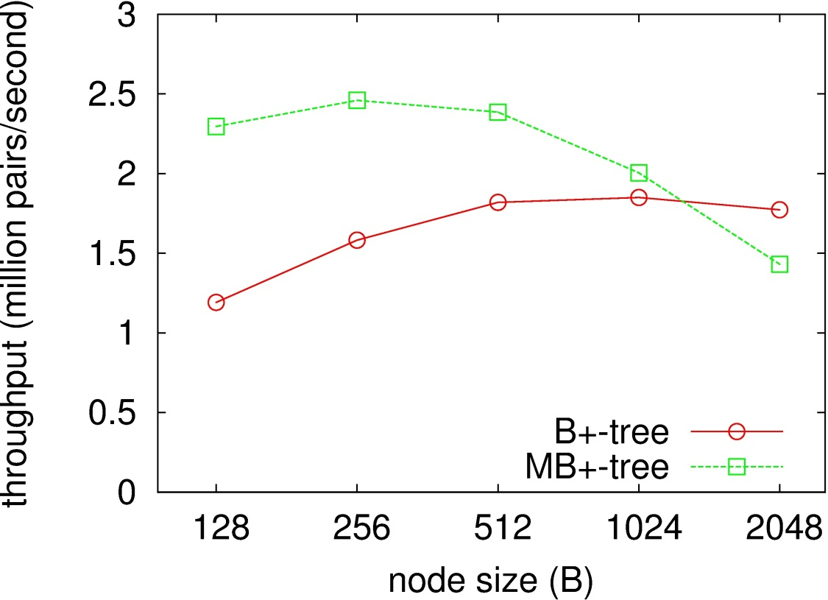
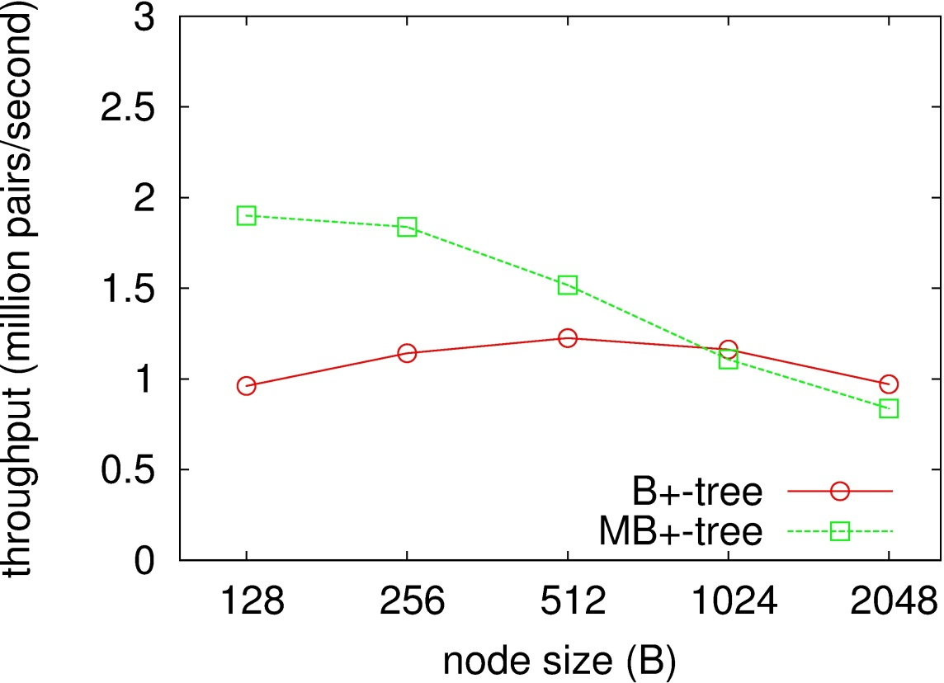
Baseline performance of MB+-tree (2/2)
Get operations
Put operations
MB+tree is faster than Google’s B+-tree
comparing at each best node size
Notes:
Here is the comparison.
Green line is MB+-tree, and red line is Google’s B+-tree.
X-axis is node size, and Y axis is throughput.
Left graph shows throughput of get operations, and right graph shows that of put operations.
The graph shows that MB+-tree is faster than Google’s B+-tree, comparing at each best node size, here, and here.
This shows that MB+-tree is properly implemented.

Slide 11
Optimize basic B+-tree performance with SIMD instructions
Optimize basic B+-tree performance with SIMD
(all nodes are the same type)
Replace leaf node with write optimized node
Replace root node with read optimized node
Utilize large pages and software prefetch at each level
Notes:
OK, then let’s move on to optimizing basic B+-tree performance with SIMD instructions.

Slide 12
Optimize basic B+-tree performance with SIMD instructions (1/2)
SIMD instructions:
process multiple data elements at once Intel SSE: 128 bit, Intel AVX: 256 bit length
Find the best configuration with evaluation
Evaluation configuration
nodes are sorted
search algorithm: linear, linear with SSE, linear with AVX, binary
evaluated throughput with varying node size
e.g.
+
11
=
13
23
1
4
2
17
8
3
6
9
7
Notes:
SIMD instructions process multiple data elements at once.
For example, in this case, these vectors of elements are added in parallel.
Recent Intel CPU supports two kinds of SIMD instructions, SSE and AVX.
Vector length of SSE is 128 bit, and that of AVX is 256 bits.
Using SIMD instructions, we want to find the best configuration with evaluation.
Evaluation configuration is as follows.
Nodes are sorted.
Search algorithm is linear search, linear search with SSE, linear search with AVX, and binary search.
We evaluated throughput with varying node size like before.

Slide 13
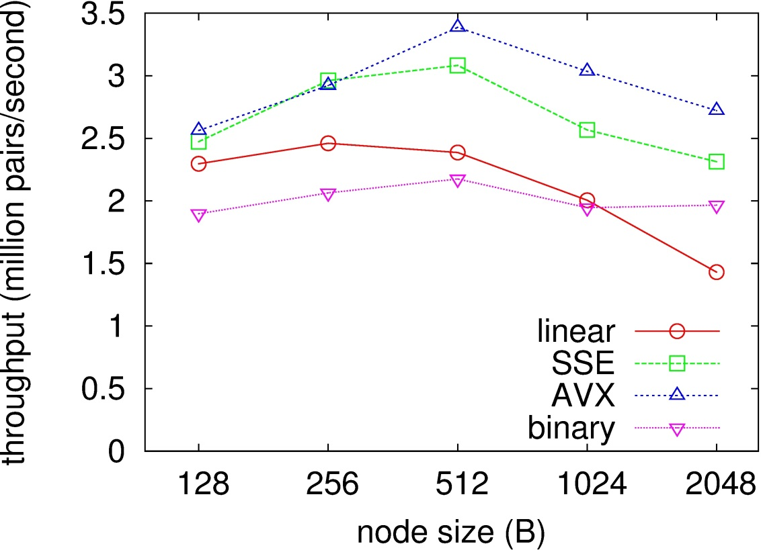
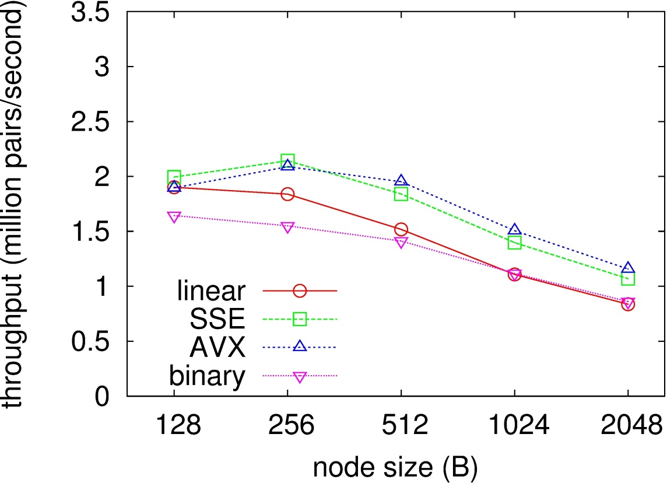
Optimize basic B+-tree performance with SIMD instructions (2/2)
Get operations
Put operations
Select linear search with AVX, 512 Byte node
(256 Byte put performance is better but similar)
Notes:
Red line is linear search.
Green line is linear search with SSE.
Blue line is linear search with AVX.
And purple line is binary search.
X-axis is node size, and Y axis is throughput.
Left graph shows throughput of get operations, and right graph shows that of put operations.
In the case of get operations, linear search with AVX, 512 Byte node is the fastest.
In the case of put operations, linear search with SSE, 256 Byte node is the fastest.
Here, we select linear search with AVX, 512 byte node,
because its put performance is similar to the fastest performance.

Slide 14
Replace leaf node with write optimized node
Optimize basic B+-tree performance with SIMD
(all nodes are the same type)
Replace leaf node with write optimized node
Replace root node with read optimized node
Utilize large pages and software prefetch at each level
Notes:
Next, we will replace the leaf node with write optimized node.

Slide 15
What are write optimized nodes like? (1/2)
If node size is small, costly split occurs frequently
10
10
split
34
23
61
96
34
58
23
75
58
61
96
75
If node is sorted, we need to move data to keep the node sorted
63
move
63
58
61
75
96
58
61
75
96
If node size is large, we can insert many keys without split
If node is unsorted, we can just append the data
49
61
96
34
58
23
75
10
Large unsorted node is better?
Notes:
So what are write optimized node like?
If node size is small, costly split occurs frequently, like this picture.
If node size is large, we can insert many keys without split.
In addition, if node is unsorted, we can just append the data, without moving data.
So, large unsorted node seems to be better.

Slide 16
What are write optimized nodes like? (2/2)
If duplicate keys may be inserted, search must be performed before insertion
if nodes are large unsorted, search might take a long time
Evaluation configuration
Keys: allow duplicate keys / guarantee unique keys in the case of unique keys, no search was performed
nodes: sorted (duplicate) / unsorted (both)
evaluated throughput with varying node size
58
Check if the same key exists or not
Append a new key or update the key
61
96
34
58
23
75
10
49
Notes:
However, if duplicate keys may be inserted, search must be performed before insertion.
In this picture, if ‘58’ is inserted, it should be updated by the new value.
Therefore, we need to check if the same key exists or not, and append a new key or update the key.
If nodes are large unsorted, search might take a long time.
So we evaluated under following configuration:
Keys are two types: duplicate keys are allowed, and their uniqueness is guaranteed.
Nodes are sorted in the case of duplicate keys, and unsorted in both cases.
We evaluated throughput with varying node size like before.

Slide 17
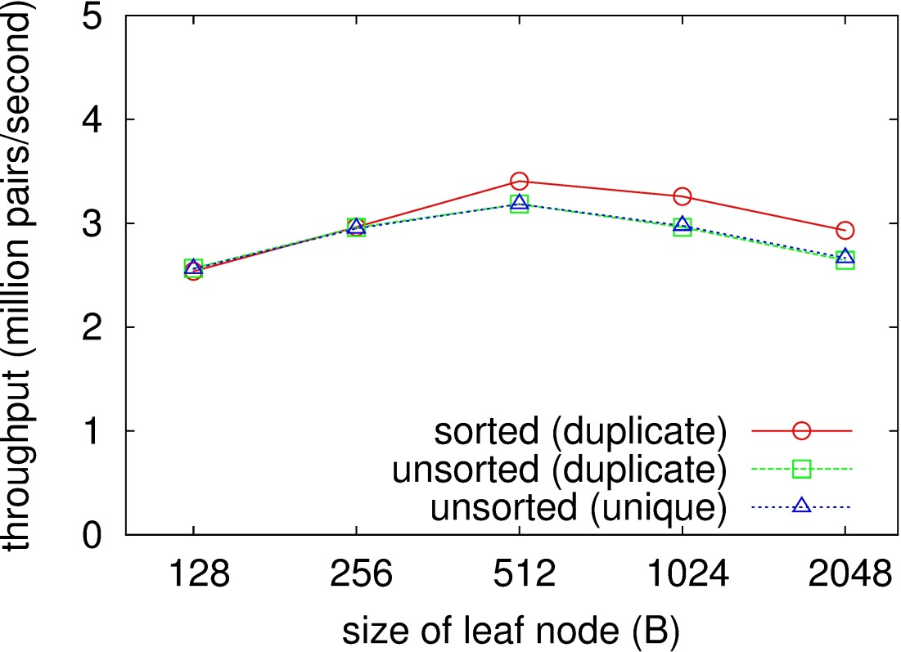
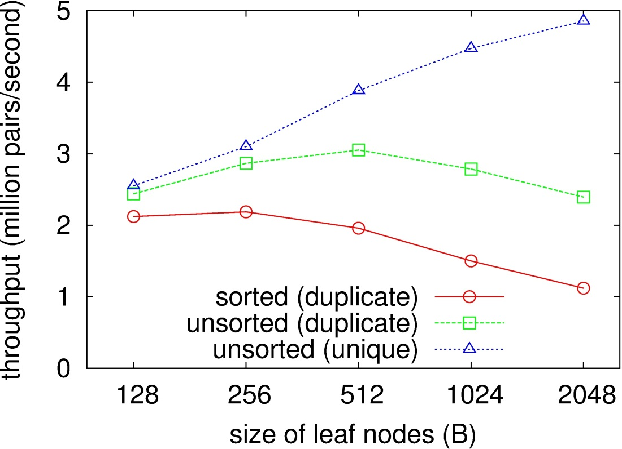
Evaluation result for replacing leaf node
Get operations
Put operations
Get throughput of unsorted node is slightly worse than sorted node
Put throughput of unsorted node is much better than sorted node
If keys are unique, large node size is better
Considering get performance and duplicate keys,
select 512 Byte unsorted node
Notes:
The red line is duplicate keys using sorted nodes.
The green line is duplicate keys using unsorted nodes.
And the blue line is unique keys using unsorted nodes.
X-axis and Y-axis is the same as before.
Left graph shows throughput of get operations, and right graph shows that of put operations.
Get throughput of unsorted node is slightly worse than sorted nodes.
On the other hand, put throughput of unsorted nodes is much better than sorted nodes.
Especially, if keys are unique, large node size is better.
Here, considering get performance and duplicate keys, we select 512 byte unsorted node.

Slide 18
Replace root node with read optimized node
Optimize basic B+-tree performance with SIMD
(all nodes are the same type)
Replace leaf node with write optimized node
Replace root node with read optimized node
Utilize large pages and software prefetch at each level
Notes:
Next, we are going to replace the root node with read optimized node.

Slide 19
What are read optimized nodes like?
Which search algorithm to use? (sorted nodes)
linear: O(n), binary: O(log₂ n), interpolation: O(log₂ log₂ n) [*] under uniform distribution
interpolation search works like binary search, except that next search space is calculated by linear interpolation
Optimal search algorithm depends on the node size:
On a small node, the order does not matter
On a very large node, the order matters
10
23
34
58
61
75
96
...
1 million keys
...
number of comparison: linear: 3 .5, binary: 3, interpolation: 2
number of comparison: linear: 0.5 million, binary: 20, interpolation: 5
Large sorted node
with interpolation search is better
Notes:
So what are read optimized nodes like?
First, which search algorithm should we use?
There are linear search, whose order is N, binary search, whose order is log n,
and interpolation search whose order is log log n.
Here, interpolation search works like binary search, except that next search space is calculated by linear interpolation.
Here, optimal search algorithm depends on the node size.
That is, on a small node, the order does not matter.
For example, if node size is 7, number of comparison of linear search is 3 -4, that of binary search is 3,
and that of interpolation search is 2. There is no much difference.
On the other hand, on a very large node, the order matters.
For example, if node size is one million, number of comparison of linear search is 0.5 million, that of binary search is 20,
and that of interpolation search is just 5.
Therefore, large sorted node with interpolation search is better.

Slide 20
How to make root node size large?
Normal B+-tree increases number of levels after large number of insertion
Root node size is not enough
If the level is limited to two, root node size becomes large enough
However, insertion to the root node occurs frequently
Large data move is needed, since it is sorted
Three level B+-tree works fine!
can make root node size large without excessive move
Notes:
So how can we make root node size large?
Normal B+-tree increases number of levels after large number of insertion.
In this case, root node size is not enough.
Then, if the level is limited to two, the root node size is large enough, but insertion to the root node occurs frequently,
which causes large data copy since it is sorted.
Therefore, as we mentioned in the title, Three level B+-tree works fine.
It can make root node size large without excessive copy.

Slide 21
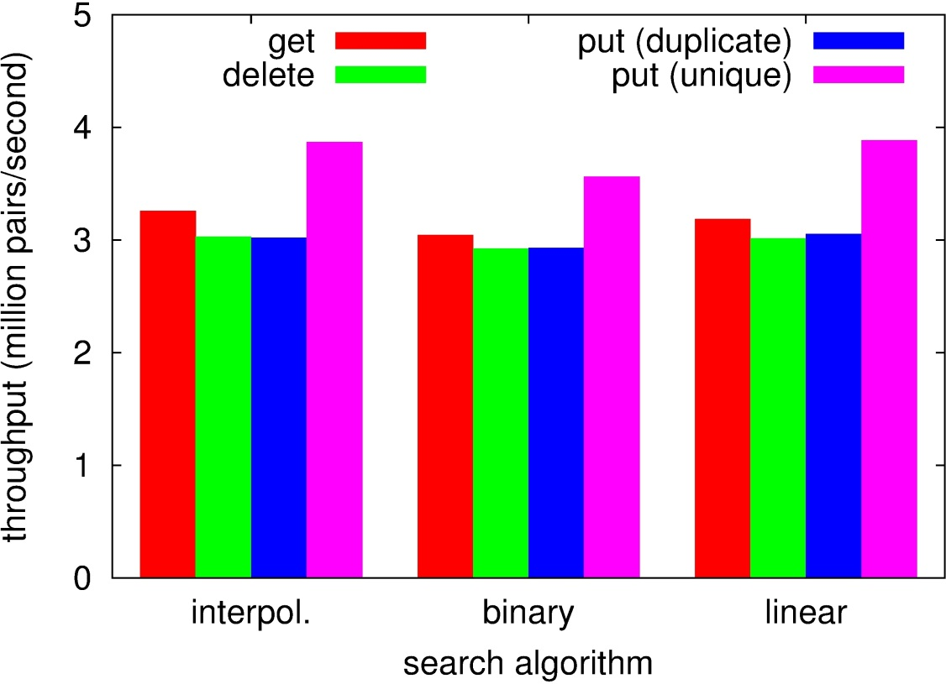
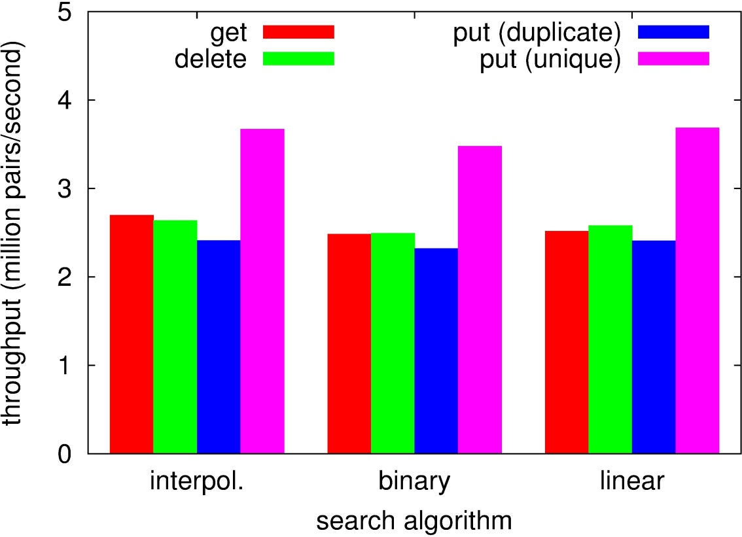
Evaluation result after replacing root node
16M pairs
32M pairs
(2017 entries at root node)
Slight get performance gain
without loss of put performance
More get performance gain
with more pairs
Notes:
Here is the evaluation result after replacing the root node.
Each group shows search algorithm. That is, interpolation search, binary search, and linear search.
The red bar shows get performance. The green bar shows delete performance.
The blue bar shows put performance with duplicate keys.
The purple bar shows put performance with unique keys.
Left graph shows performance of 16 million pairs same as previous evaluations.
Right graph shows performance of 32 million pairs.
In the case of 16 million pairs, slight get performance gain was attained without loss of put performance.
In this case, 2017 entries are stored in the root node.
If more pairs are inserted to the tree, more get performance gain was attained.
So using interpolation search would become effective with more pairs.

Slide 22
Replace leaf node with write optimized node
Optimize basic B+-tree performance with SIMD
(all nodes are the same type)
Replace leaf node with write optimized node
Replace root node with read optimized node
Utilize large pages and software prefetch at each level
Notes:
Lastly, we utilize large pages and software prefetch.

Slide 23
Large pages to reduce TLB misses
TLB (Translation Lookaside Buffer) is cache of a table that translates virtual address to physical address
Recently, memory size is getting large, which increases the table size
TLB misses often happen, which decreases performance
Making the page size large can reduce table size, which reduces TLB misses
Memory
page
Memory
page
TLB
TLB
Notes:
We utilized large pages to reduce TLB misses and software prefetch to reduce cache misses.
TLB, Translation Lookaside Buffer, is cache of a table that translates virtual address to physical address.
Making the page size large can reduce table size, which reduces TLB misses, like this picture.

Slide 24
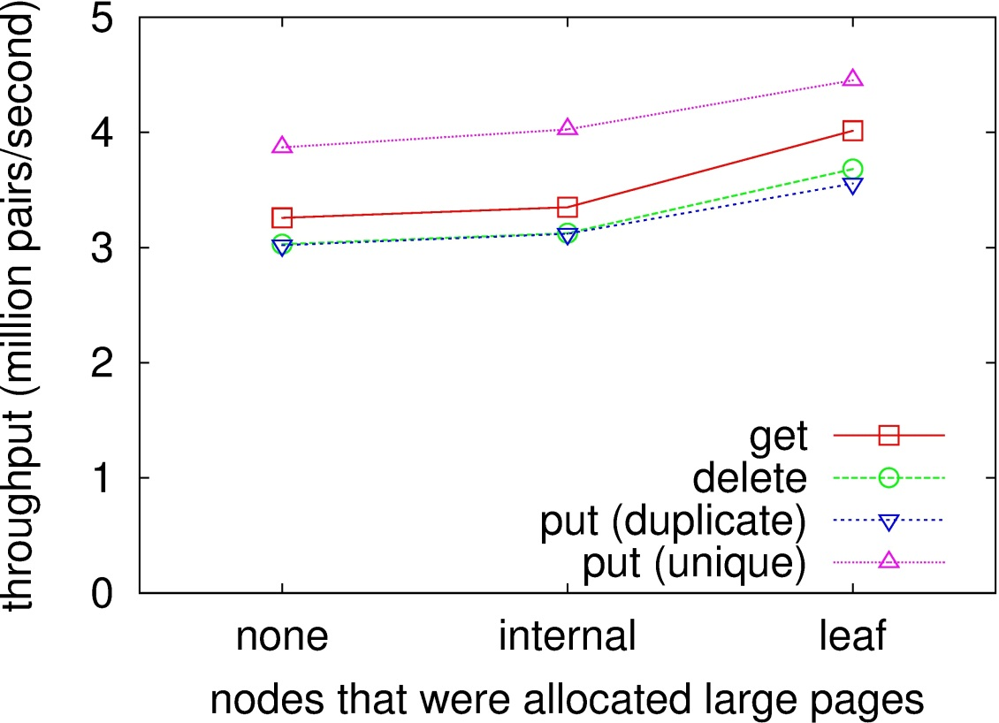
Which level should be allocated on large pages?
root+middle
root+middle nodes required 4 large pages, which increased 3% of throughput
Leaf nodes required 206 large pages, which increased 20% of throughput
Large pages should be allocated to root+middle nodes before leaf nodes
(performance improvement per number of large pages is better)
Notes:
So which level should be allocated on large pages?
This graph shows throughput of using large pages on each levels.
Here is no large pages, here root and middle node are allocated on large pages,
and here leaf nodes are allocated on large pages.
root and middle nodes required 4 large pages, which increased 3% of throughput.
leaf nodes required 206 large pages, which increased 20% of throughput.
Therefore, large pages should be allocated to root and middle nodes first, before leaf nodes,
since performance improvement per number of large pages is better on these nodes.

Slide 25
Software prefetch to reduce cache misses
Software prefetch can load specified data into cache
In the node, “keys” and “links” to lower level are stored in different memory area
Prefetching “links” before the key search will reduces cache misses
node
search
Keys
different memory area
prefetch before search
links
points to the nodes of lower level (or value)
Notes:
Next, we used software prefetch to reduce cache misses.
Software prefetch can load specified data into cache.
In our implementation, keys and links to lower level are stored in different memory area, like this picture.
Therefore, prefetching links before key search will reduce cache misses.

Slide 26
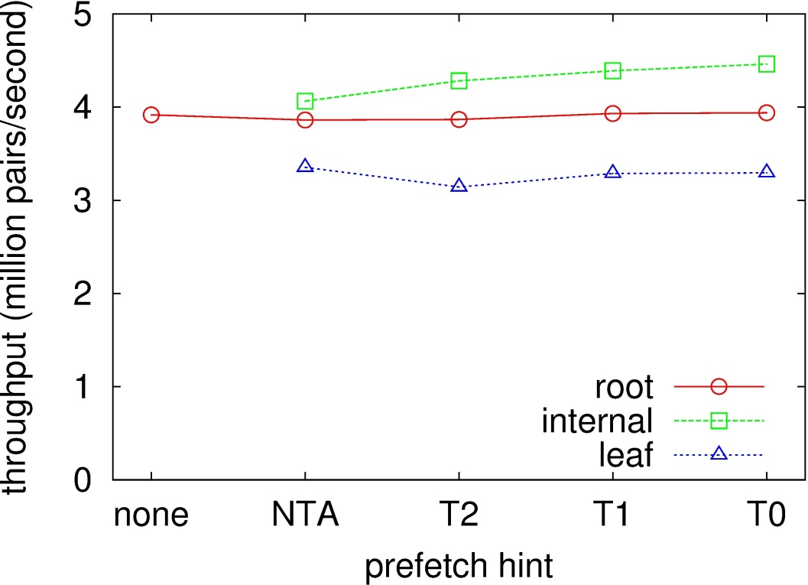
Which level should use prefetch?
middle
leaf
NTA: prefetch to L1 w/o L2 and L3
T2: prefetch to L3
T1: prefetch to L2 and L3
T0: prefetch to L1, L2, and L3
middle
Get operations
Root nodes: does not affect
basically already cached
Leaf nodes: decreases performance
excessively evicts links on middle nodes
Middle nodes: increases performance
Only middle nodes
should use prefetch
Notes:
So which level should use prefetch?
This graph shows improvement of throughput using prefetch on each level.
The red line shows root node, the green line shows middle node, and the blue line shows the leaf node.
X-axis shows cache hints.
Prefetching on the root node does not affect the performance, because it is basically already cached.
Prefetching on the leaf nodes decreases performance, because it excessively evicts links on middle nodes.
Prefetching on the middle nodes increases performance.
Therefore, only middle nodes should use prefetch.

Slide 27
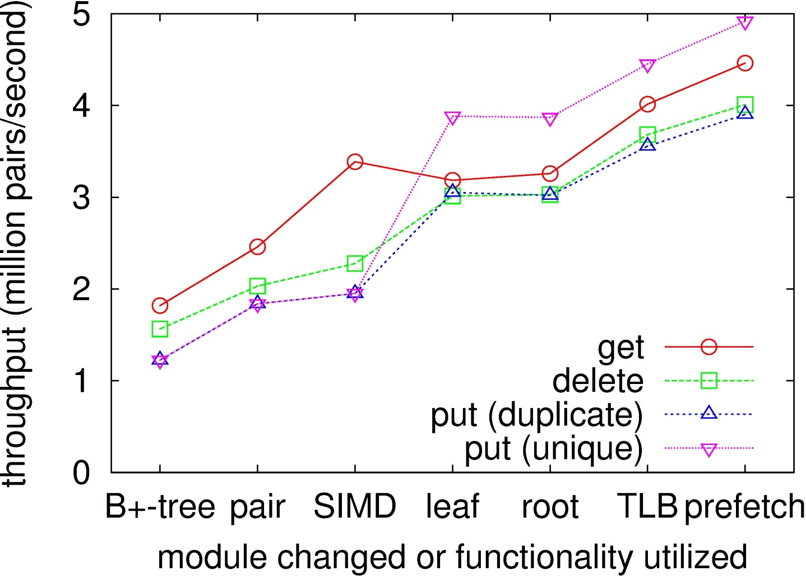
Overall performance gain
Base
2.5 times faster (get)
2.6 times faster (delete)
3.2 times faster (put, duplicate keys)
4.0 times faster (put, unique keys)
Notes:
This graph shows the overall performance gain.
Y-axis shows the throughput, and X-axis shows the each improvement.
Namely, Google’s open source B+-tree, baseline performance, using SIMD instruction, replacing leaf node,
replacing root node, using large pages, and using prefetch.
The red line shows get performance, the green line shows delete performance, the blue line shows the put performance of duplicate keys, and the purple line shows the put performance of unique keys.
This graph shows that MB+-tree performs 2 to 4 times faster than the Google’s open source B+-tree.

Slide 28
Conclusion
We modularized B+-trees, and showed that using different configuration at each level improved performance
Effective selection of configurations: Three level B+-tree with
unsorted 512 Byte leaf node
sorted 512 Byte middle node w/ linear search, prefetch
sorted large root node w/ interpolation search
together with AVX, large page showed the best performance
2.5 – 4 times performance improvement was attained
Future work
Automatic configuration selection according to hardware and workload characteristics
Notes:
Conclusion
We modularized B+-trees, and showed effective selection of algorithms and node sizes.
That is, three level b+-tree with unsorted 512 byte leaf node, sorted 512 byte middle node with linear search and prefetch, and sorted large root node with interpolation search, together with AVX, and large page showed the best performance.
2-4 times performance improvement was attained.
Future work includes automatic algorithm and node size selection according to the workload characteristics.
Thank you for your attention.

Slide 30
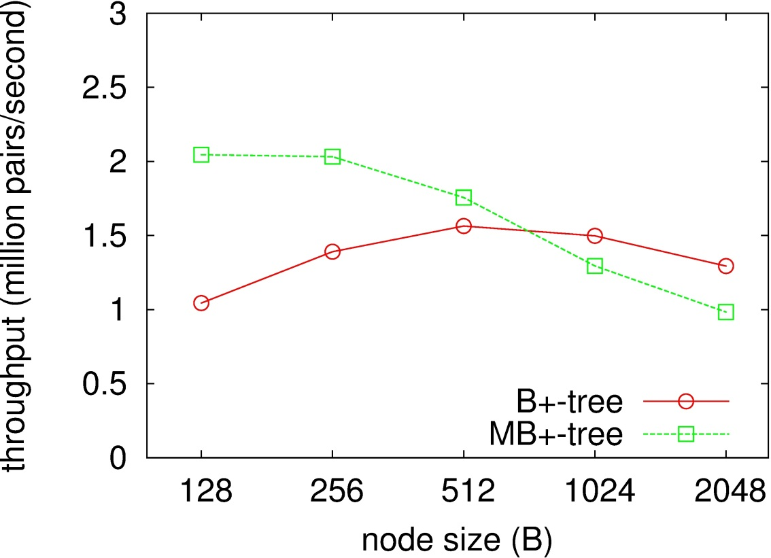
Baseline performance of MB+-tree
Delete operations
Throughput of delete was between that of get and put
Focus on throughput of get and put
Notes:
Throughput of delete operations was between that of get and put operations.
Therefore, we focus on throughput of get and put operations.

Slide 31
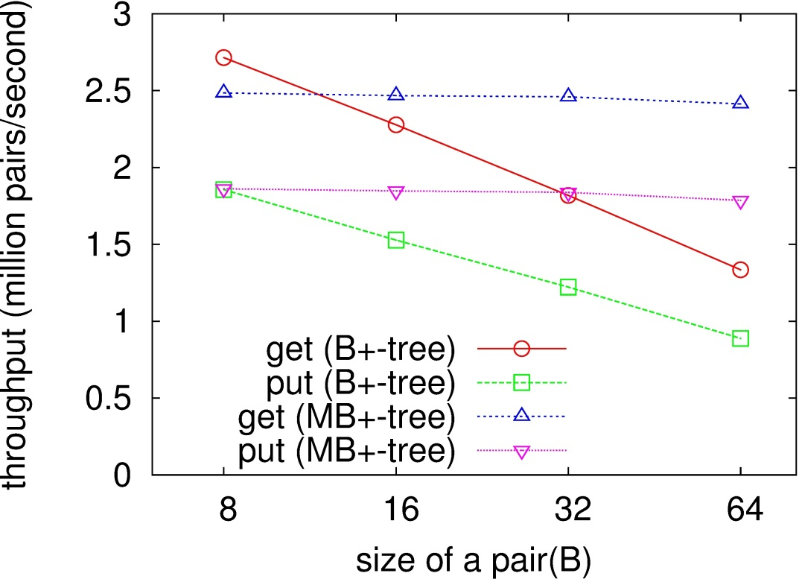
Why faster than Google’s B+-tree?
Google’s B+-tree stores values at leaf node
MB+-tree stores values at different place
Google’s B+-tree becomes slower when value size is large, because of node management cost
Node size:
MB+-tree: 256 bytes
B+-tree: 512 bytes
Notes:
The size of pairs affected very little on throughput in the MB+-tree.
The node size in the MB+-tree was 256 bytes and that in the B+-tree was 512 bytes because the trees achieved a good performance in total
In the evaluation of MB+-trees, we do not have to pay much attention to the pair size while the B+-tree was sensitive to the pair size.

Slide 32
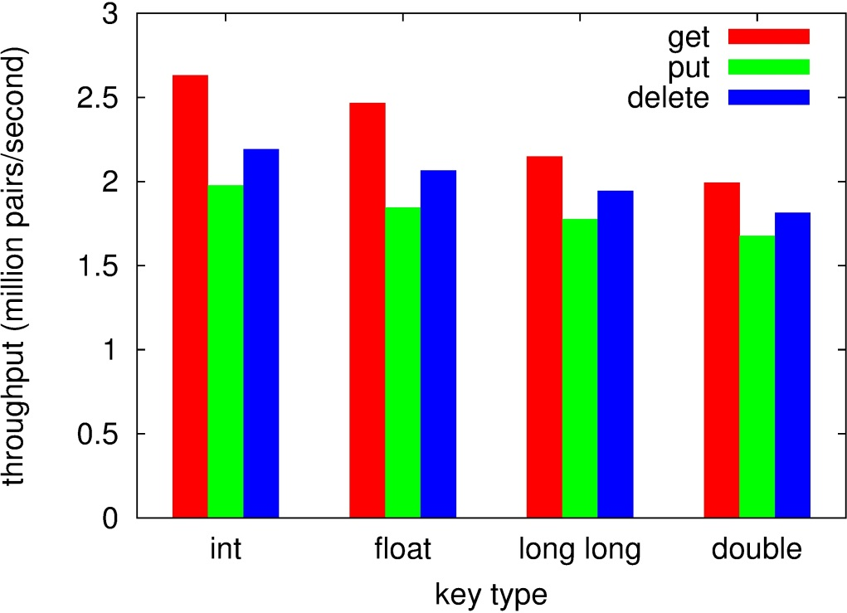
Influence of key types on throughput was limited in the MB+-tree
The size of keys affected throughput more than the type of keys did
Float keys could be an appropriate assumption because
the type of keys does not matters significantly
existing works provided techniques to make large keys small
Notes:
Influence of key types on throughput was limited in the MB+-tree.
However, the size of keys affected throughput more than the type of keys did.
Float keys could be an appropriate assumption because the type of keys does not matters significantly, and existing works provided techniques to make large keys small

