Slide 1
A first step towards GPU-assisted Query Optimization
Max Heimel
Volker Markl
Presented by Kostas Tzoumas

Slide 2
Agenda
Introduction & Motivation.
A Proof of concept.
Evaluation.
Conclusion & Future Work.

Slide 3
Agenda
Introduction & Motivation.
A Proof of concept.
Evaluation.
Conclusion & Future Work.

Slide 4
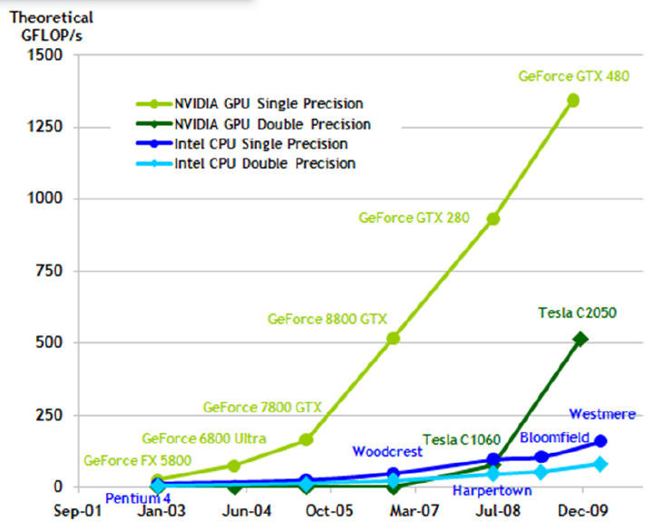
The advent of GPGPU in databases
Modern GPUs are fully programmable, massively parallel co-processors.
Frameworks like OpenCL and CUDA allow to run arbitrary computations
Raw compute power outperforms modern CPUs by a huge margin (~ 10x).
They are coupled with high-bandwidth memory.
GPUs are an interesting platform for accelerating databases.
Active research topic for several years.
Main Focus: Running database operators on the GPU.
Selection, Join, Aggregation, Grouping, Sorting, Transactions...
Often demonstrate significant speedups.
However: There are some limitations ...
Notes:
GPUs offer much more raw compute power than CPUs (roughly a factor of ten).
For cmp: Latest Sandy Bridge Intel CPU: ~100Gflops. Latest Nvidia GPU: ~1TFlops
Graphics cards couple high compute power with strong IO performance
➔ Very interesting target for running database operations.
GPU-accelerated databases has been an active research topic for several years.
Efficient GPU-accelerated versions of almost all major database operators have been presented.
However, there are some limitations when running database code on a graphics card.

Slide 5
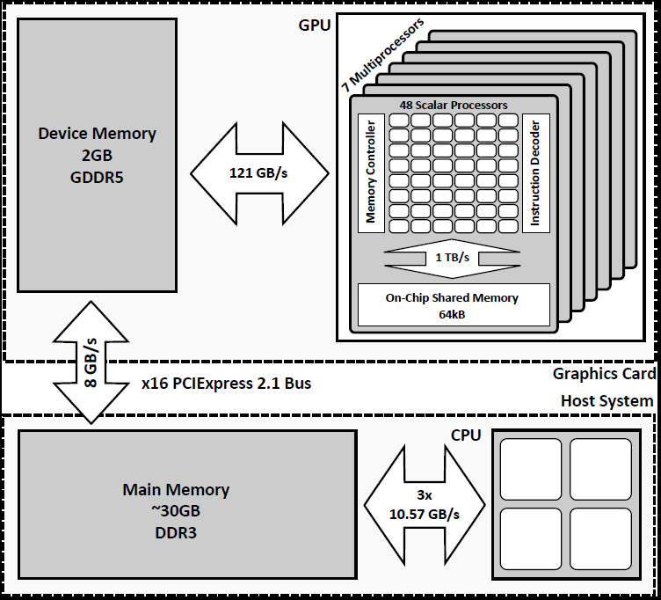
Background: Graphics Cards Architecture
GPU can only operate on data in device memory
➔ All data has to pass through here!
Transfer to graphics card is slower than Access to main memory!
→ Minimize data transfer between host and graphics card.
→ I/O-bound problems can only benefit if data is already on the GPU!
Notes:
Quick excursuson graphics card architecture to understand the next slide.
Graphics Card = GPU + Device Memory
GPU can only operate on data that is located in the device memory.
Someone might object here: Nvidia offers unified host addressing (i.e., GPU can access main memory). However, this is only a convenience technology! The data is still transferred to the device memory on the graphics card behind the curtains.
→ All payload has to pass through the PCIexpress bus, which is comparably slow.
➔ This transfer is the bottleneck and should be avoided where possible!
Since the PCIexpress bus is slower than main memory, I/O bound problems are always faster on the CPU if the data is not already on the graphics card.
In the time that the data has arrived in device memory, the CPU has already finished the computation.

Slide 6
Problems with GPU-accelerated operators
Restricted to small data sets:
Operators are typically I/O-bound & device memory is rather small (2-8 GB).
Requires selecting a hot-set of data that is GPU-resident.
Another problem: Unpredicted large return sizes might overflow available memory.
Query optimization becomes more difficult:
Plan-space is inherently larger.
Complicated cross-device cost functions are required.
They only benefit in-memory databases systems:
If the data is kept on disk, most time is spent on disk I/O.
GPU can only accelerate once data is in main memory, which is typically neglible.
➔ Further research is required to make GPUs a useful platform for production database systems!
Notes:
Based on the previous slide (avoid data transfer) make the point that the existing approach (running database operators on the GPU) has some major drawbacks:
It is restricted to small datasets. Operators are I/O bound (i.e. require their input to be in device memory to be efficient, see last slide) and device memory is limited. Thus, only a small subset of the data can usually be accelerated.
Also: Unpre
Query optimization gets more complicated due to the additional options and cross-device execution costs.
They only benefit in-memory database systems. „Traditional“ DB systems would only see minor improvements from using a graphics card.

Slide 7
GPU-assisted Query Optimization
Suggestion: Investigate GPU usage in Query Optimization.
Typically compute-intensive and compute-bound.
Negligible – and predictable – result sizes.
Operates on comparably small input data.
What do we gain from this?
Faster optimization (not really an issue).
However: Additional compute power can be used for „more expensive“ operations:
Better cardinality estimates.
Reduced search space pruning.
More complex optimization algorithms.
→ Main Goal: Improved Plan Quality!
➔ Indirect acceleration of the database, without actually running operator code on the GPU!
Would allow to accelerate disk-based systems with a GPU.
Approach can complement existing work on GPU-accelerated operators.
Notes:
Here, we introduce

Slide 8
Agenda
Introduction & Motivation.
A Proof of concept.
Evaluation.
Conclusion & Future Work.

Slide 9
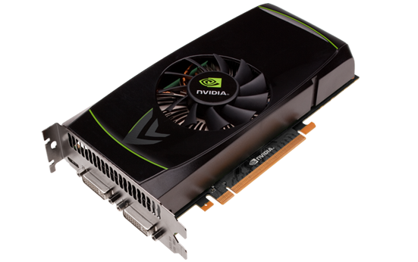
GPU-Assisted Selectivity Estimation
Relational Data
Statistics Collection
Statistics
Statistics Collection
System
Catalog
Statistics
Query
AST
Plan
Result
SQL Parser
Query Optimizer
Execution Engine
Query Optimizer needs accurate estimates of intermediate result sizes.
Selectivity estimation: Estimate how many tuples qualify a given predicate.
Bad estimates often lead to the optimizer making wrong decisions.
Idea: Improve estimation quality by using the GPU.
Keep a statistical model of the data in the device memory.
Then run a more expensive - but more accurate - estimation algorithm.
Notes:
Introduce the idea of running Selectivity Estimation on the graphics card as a proof of concept.

Slide 10
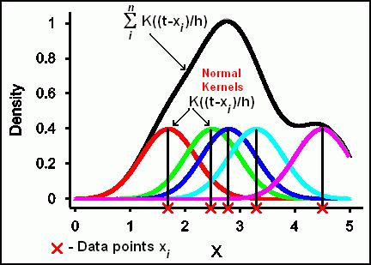
Background: Kernel Density Estimation
Kernel Density Estimation (KDE) is a non-parametric method for density estimation.
General idea: Use the observed points (sample) to construct the estimator.
Each observed point distributes „probability mass“ to its neighborhood.
➔ Shape of distribution controlled by local density functions (Kernels).
➔ The estimate at a point is the total „probability mass“ from all observed points.
Amount of „probability mass“ from .
Local probability density function.
Bandwidth: Controls spread and orientation of the local density.
Kernel: Shape of the local probability density.

Slide 11
Why Kernel Density Estimation?
Nice statistical properties:
Proven to converge faster to the true distribution than histograms.
Probability estimate is continuous (smooth).
Simple to construct and maintain:
Only requires collecting and maintain a representative sample.
KDE automatically captures correlation patterns within the data:
No need for Independence Assumptions or Multidimensional Histograms.
But: Curse of Dimensionality still applies (~ problematic for dimensions > 10).
Easy to run efficiently on a graphics card:
Trivially to parallelize: Compute local contributions in parallel, then sum them up.
Only significant required data-transfer is copying model
This happens only once!
Notes:
KDE Parallelization: Compute contribution from each point in the sample, then sum all contributions up.

Slide 12
Implementation Overview I
We integrated a GPU-accelerated KDE variant into the query optimizer of PostgreSQL.
Supports estimates for range queries on real-valued columns.
Usage is completely transparent to the user.
We use OpenCL to run code on the GPU.
Open, platform-independent standard.
Allows running code on multiple hardware platforms:
GPUs, Multi-Core CPUs, FPGAs, ...
Allows dynamic compilation of GPU code at runtime.
E.g. used to dynamically unroll loops.
Two main code-parts:
Estimator.
Integration into the Postgres Optimizer (Setup, Glue-Code).
GPU-accelerated
Notes:
Completely transparent: The system automatically generates the model on the GPU during ANALYZE if: a) a GPU is present b) GPU mode was activated by the administrator (SET enable_ocl TO true) c) The analyzed table is real-valued. The optimizer transparently uses the GPU model, if one is available.

Slide 13
Implementation Overview II
Model Creation: „Generate the KDE model for a relation.“
Runs once during ANALYZE command.
Main Tasks:
Select the sample size & generate the sample.
Model Setup: „Prepare the KDE model for a relation.“
Runs once at server startup.
Main Tasks:
Set up all required resources on the GPU.
Transfer the sample to the graphics card’s device memory.
Estimator: „Base-table Selectivity Estimation.“
Runs whenever the optimizer needs a selectivity estimate.
Main Tasks:
Compute the estimated selectivity for the given query on the GPU.

Slide 14
Agenda
Introduction & Motivation.
A Proof of concept.
Evaluation.
Conclusion & Future Work.

Slide 15
Evaluation Disclaimer
Evaluation System:
CPU: Intel Xeon E5620 (Quadcore @ 2.4GHz).
Graphics Card: Nvidia GTX460 (336 compute cores, 4GB device memory).
Main goal: Demonstrate that using a GPU can improve estimation quality.
Compare runtime between GPU and CPU.
Demonstrate higher estimation quality.
We won‘t demonstrate that improved estimations lead to better plans.
➔ This has been discussed extensively in previous work.
Benchmarks against the CPU were made using the Intel OpenCL SDK.
Identical codebase was used for both GPU and CPU.
SDK automatically vectorizes and parallelizes code to run efficiently on the CPU.

Slide 16
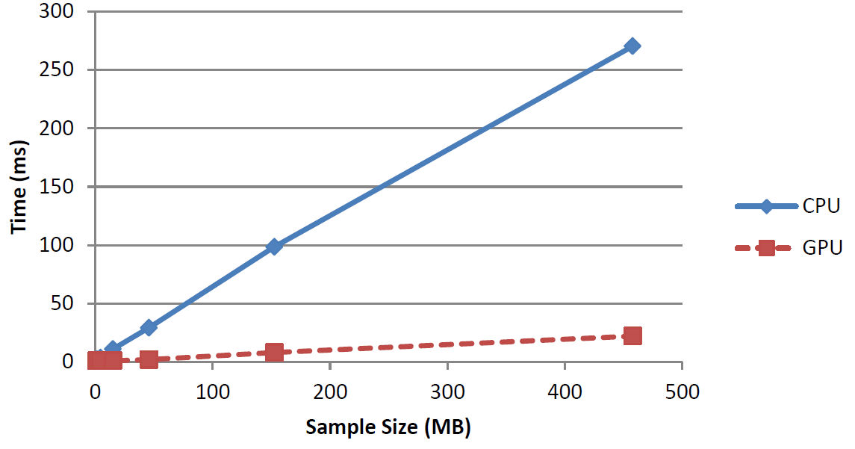
Evaluation: Performance
Is the GPU actually faster than the CPU?
Data: Random, synthetic data.
Experiment: Measure estimation time on both CPU and GPU with increasing sample size.
GPU gives a ~10x speed-up for identical sample sizes.
Or: Given a time budget, the GPU can use a ten times larger sample!
➔ In general, larger samples result in better estimation quality.
Notes:
Note: Even for extreme large samples (~512 MB), the GPU computes an estimate in less than 25ms!

Slide 17
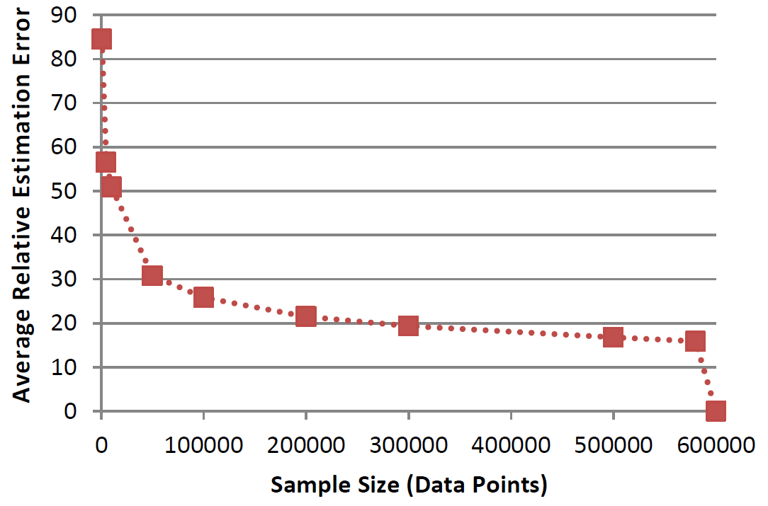
Evaluation: Quality Impact of Sample Size.
Which impact has the increased sample size on estimation quality?
Data: Six-dimensional, real-world dataset from UCI Machine Learning Repository.
Experiment: Measure average relative estimation error with increasing sample size for random, non-empty queries.
Estimation error behaves like $O\left(n^{−\frac{4}{5}}\right)$ wrt sample size n.
➔ Increasing the sample by a factor of 10 reduces the error roughly by a factor 7!
Est. error for Vanilla Postgres roughly here.
Complete dataset in sample.

Slide 18
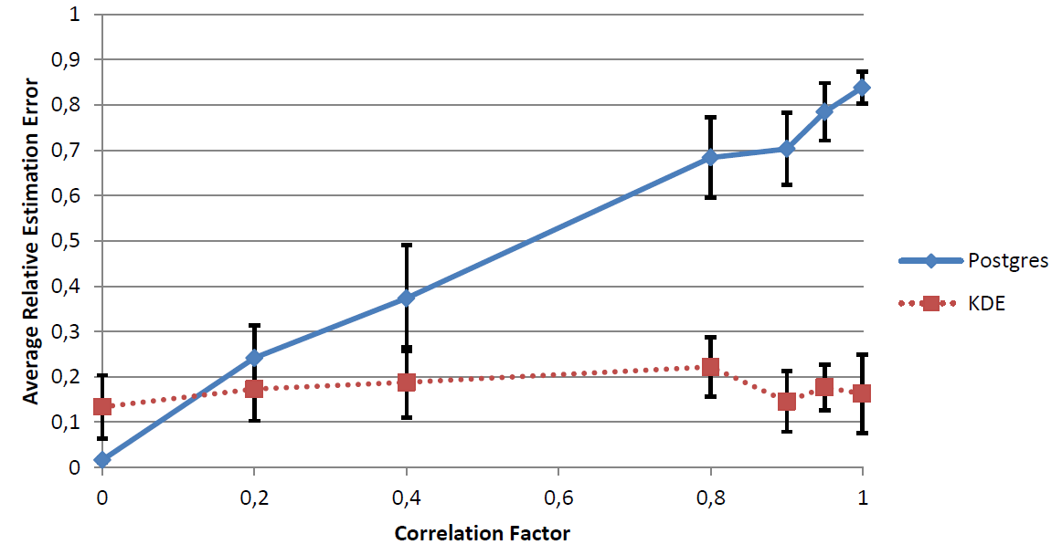
Evaluation: Impact of Correlation
How does the estimator compare for correlated data?
Data: Synthetic, two-dimensional random normal data sets, generated with increasing covariance between dimensions.
Experiment: Measure average relative estimation error for Postgres and KDE for non-empty range queries.

Slide 19
Agenda
Introduction & Motivation.
A Proof of concept.
Evaluation.
Conclusion & Future Work.

Slide 20
Take-Home Messages
Modern GPUs offer a massive amount of raw computational power.
➔ We want to harness this power in a database setting!
However: GPU-accelerated database operators are hard to get right.
Limited device memory, unpredictable result sizes, PCIExpress transfer Bottleneck.
GPU will only speed up some cases → Cross-Device Query Optimization required.
Complementary approach: Utilize GPU for Query Optimization.
Additional compute power allows spending more resources on Query Optimization.
This could lead to better plan quality (e.g.: due to less search space pruning).
➔ GPU could accelerate database without running operator code!
Proof-of-concept: Run selectivity estimation on the GPU.
Additional compute power allows using more elaborate estimation techniques.
→ Improved selectivity estimates.
➔ Improved plan quality.

Slide 21
Future Work
Identify further operations in the optimizer where additional compute power could improve quality.
Join-order enumeration.
Top-down query optimization.
Continue evaluating GPU-accelerated selectivity estimation.
Are other estimation algorithms better suited?
Histograms, Wavelets
Can we extend the model to discrete and categorical data?

Slide 22
Thank you!

