Slide 1
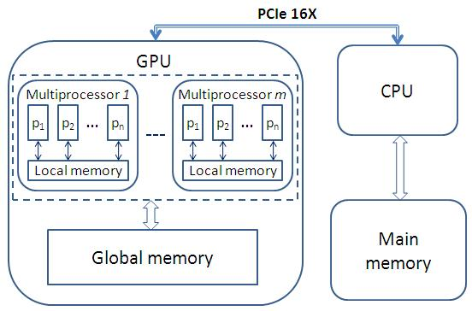
A Parallel Twig Join Algorithm for XML Processing using a GPGPU
1a
b3
c3
d3
b1
e1
b3
b2
c2
d2
a1
b1
c1
d1
e1
f1
c1
1d
f1
b2
c3
d3
Lila Shnaiderman Oded Shmueli
CS Faculty Technion
August 27, 2012
Istanbul
2c
d2

Slide 2
Background
XPath:
The most popular query language for XML.
Twig Pattern (twig query): pattern of selection predicates on multiple elements in a tree.
Answer to a query:
All occurrences of twig pattern in an XML DB.
Different than XPath semantics.
Variant: just answer nodes, similar to XPath.
Desire
Improve processing time of a twig query.
Approach:
Speed XPath processing using GPGPU!

Slide 3
XML Usage in modern systems
The DB2 Universal Database system.
Enhanced with comprehensive Native XML support.
The Oracle XML DB.
provides Native XML support.
Natix, a database management system.
Built from scratch - for storing and processing XML data.
Relational Over XML - ROX scenario:
efforts to enhance SQL, so as to allow it access to natively stored XML data, through traditional SQL interfaces.
3/16
Notes:
You may not have time for this slide

Slide 4
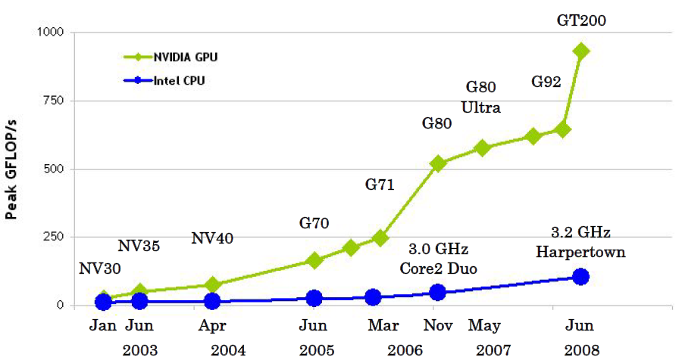
GPU overview
Highly Parallel, Multithreaded, Manycore Processor
Supports thousands of concurrent threads.
In GTX 480:
15 MPs
1536 threads per MP
actually in parallel 15*32 (480).
SIMD style
High arithmetic intensity hide memory access latency
4/16

Slide 5
XML DB model (1)
Database:
forest of rooted, ordered, labeled trees.
Node: element or value.
Edge: element – sub element, element-value relationship.
Twig pattern: An ordered labeled tree.
Node: element tags or string values.
Edge: parent-child (single line) or ancestor-descendant (double line).
Match of Q in D:
Given a twig pattern Q (query) and an XML DB D, mapping from Q to D such that:
each Q node maps to some node in D.
the structural relationships between Q nodes are satisfied by the corresponding DB nodes (sibling order can be any).
5/16
Notes:
Be systenmatic with periods at ends of sentences in this and other slides

Slide 6
XML DB model (2)
Answer to Q with n nodes:
Full answer: n-ary relation. Each tuple (d₁,..., d_{n}) consists of a distinct match of Q in D.
Answer nodes: Images of rightmost leaf node of Q in matches of Q in D.
Twig Pattern Matching problem:
Given a query twig pattern Q and an XML DB D (represented via streams), compute the answer (all matches, or answer nodes) to Q in D.
Stream T_{q}:
Extends the inverted index data structure used in DBs.
Separate stream for each element label.
Stream ‘a’ contains positional representations of DB nodes whose labels are ‘a’: (DocId,LeftPos:RightPos, LevelNum)
6/16

Slide 7
XML streams DB example
1:26
Movie
2:5
6:15
16:25
Name
Actor
Actor
3:4
7:10
11:14
17:20
21:24
Harry Potter
First
Last
First
Last
8:9
12:13
18:19
22:23
Daniel
Radcliffe
Rupert
Grint
16:25,2
17:20,3
21:24,3
1:26,1
2:5,2
6:15,2
7:10,3
11:14,3
Movie
Name
Actor
First
Last
3:4,3
8:9,4
18:19,4
12:13,4
22:23,4
Harry Potter
Daniel
Rupert
Radcliffe
Grint
7/16

Slide 8
New Extended Stream Storage Scheme
Encode additional structural characteristics of the document tree within the streams
Each node has link to its ancestors.
1:26,1
1:26
Movie
Movie
2:5,2
16:25,2
2:5
6:15,2
Name
16:25
Name
Actor
Actor
3:4
17:20
21:24
3:4,3
17:20,3
21:24,3
Harry Potter
First
Last
7:10,3
11:14,3
Harry Potter
18:19
22:23
First
Last
Rupert
Grint
6:15
Actor
7:10
11:14
8:9,4
18:19,4
12:13,4
22:23,4
First
Last
Daniel
Rupert
Radcliffe
Grint
8:9
12:13
Daniel
Radcliffe
8/16

Slide 9
GPU-Twig (first phase)
Copy query relevant data streams from CPU memory to GPU global memory.
While there are unprocessed nodes in the query tree (qTree)
Choose node q from qTree
(such that all q’s child nodes were already processed)
Derive structural information of all nodes n in the stream with q’s label name.
Each node is processed by a different thread!
Mark if n is “an answer” of the sub query rooted at q.
9/16

Slide 10
GPU-Twig (first phase)
1:38,1
r
2:7,2
8:25,2
26:37,2
1 | 2 | 3 | 4 | 5
0 | 1 | 0 | 0 | 1
a
1 | 2 | 3 | 4 | 5
0 | 1 | 1 | 0 | 1
a
1 | 2 | 3 | 4 | 5
0 | 1 | 1 | 0 | 0
a
3:4,3
5:6,3
9:16,3
17:22,3
23:24,3
27:32,3
33:36,3
1 | 2 | 3 | 4 | 5
0 | 0 | 0 | 0 | 0
c
1 | 2 | 3 | 4 | 5
0 | 0 | 0 | 0 | 0
b
1 | 2 | 3 | 4 | 5
0 | 0 | 0 | 1 | 0
b
f
1 | 2 | 3 | 4 | 5
0 | 0 | 0 | 0 | 0
c
1 | 2 | 3 | 4 | 5
0 | 0 | 0 | 0 | 0
a
f
10:11,4
12:15,4
18:21,4
28:31,4
34:35,4
1 | 2 | 3 | 4 | 5
0 | 0 | 0 | 0 | 0
b
1 | 2 | 3 | 4 | 5
0 | 0 | 0 | 0 | 0
a
1 | 2 | 3 | 4 | 5
0 | 0 | 0 | 1 | 0
b
1 | 2 | 3 | 4 | 5
0 | 0 | 0 | 1 | 0
b
1 | 2 | 3 | 4 | 5
0 | 0 | 0 | 0 | 0
a
13:14,5
19:20,5
29:30,5
1 | 2 | 3 | 4 | 5
0 | 0 | 0 | 0 | 0
d
1 | 2 | 3 | 4 | 5
0 | 0 | 0 | 0 | 0
d
1 | 2 | 3 | 4 | 5
0 | 0 | 0 | 0 | 0
d
qTree
1
a
18:21,4 =
the open index: the close index, the depth in the document
2
b
3
b
5
c
qArray: Table indexes are the qTree indexes. The content: is current node has descendant that matches node with the given index in qTree?
4
d
10/16

Slide 11
GPU-Twig (second phase)
Goal: Find the answer nodes using the qArray structures (holding the derived info).
qPath: the path between the answer node qAnsN and the qTree root node.
AnsN is an answer:
if there is at least one match of qPath in dTree such that
AnsN node maps to qAnsN
And in all the path nodes qArray is filled according to the requirements of the relevant q node.
11/16

Slide 12
GPU-Twig (second phase)
Each node in qAnsN stream corresponds to different thread!
1:38,1
r
2:7,2
8:25,2
26:37,2
1 | 2 | 3 | 4 | 5
0 | 1 | 0 | 0 | 1
a
1 | 2 | 3 | 4 | 5
0 | 1 | 1 | 0 | 1
a
1 | 2 | 3 | 4 | 5
0 | 1 | 1 | 0 | 0
a
3:4,3
5:6,3
9:16,3
17:22,3
23:24,3
27:32,3
33:36,3
1 | 2 | 3 | 4 | 5
0 | 0 | 0 | 0 | 0
c
1 | 2 | 3 | 4 | 5
0 | 0 | 0 | 0 | 0
b
1 | 2 | 3 | 4 | 5
0 | 0 | 0 | 1 | 0
b
f
1 | 2 | 3 | 4 | 5
0 | 0 | 0 | 0 | 0
c
1 | 2 | 3 | 4 | 5
0 | 0 | 0 | 0 | 0
a
f
10:11,4
12:15,4
18:21,4
28:31,4
34:35,4
1 | 2 | 3 | 4 | 5
0 | 0 | 0 | 0 | 0
b
1 | 2 | 3 | 4 | 5
0 | 0 | 0 | 0 | 0
a
1 | 2 | 3 | 4 | 5
0 | 0 | 0 | 1 | 0
b
1 | 2 | 3 | 4 | 5
0 | 0 | 0 | 1 | 0
b
1 | 2 | 3 | 4 | 5
0 | 0 | 0 | 0 | 0
a
13:14,5
19:20,5
29:30,5
1 | 2 | 3 | 4 | 5
0 | 0 | 0 | 0 | 0
d
1 | 2 | 3 | 4 | 5
0 | 0 | 0 | 0 | 0
d
1 | 2 | 3 | 4 | 5
0 | 0 | 0 | 0 | 0
d
qTree
1
a
2
b
3
b
5
c
4
d
12/16

Slide 13
Experiments
Used XMark benchmark to build different XML docs.
Used different twig patterns.
Platform:
3 GHz Intel S5520SC ShadyCove 5520 12DDR3 6SATA/R 2LAN1000 EATX work station
NVIDIA GTX 480 GPU
Two Intel Xeon 6C X5650 processors
24GB of RAM.
Main metric of performance: run time.
Experiment input files:
An XML document.
A text file with a query (twig) patterns.
Experiment steps:
Load document d into XML Streams storage.
Run the queries on d using the CPU with 12 threads.
Run the queries on d using the GPU.
13/16

Slide 14
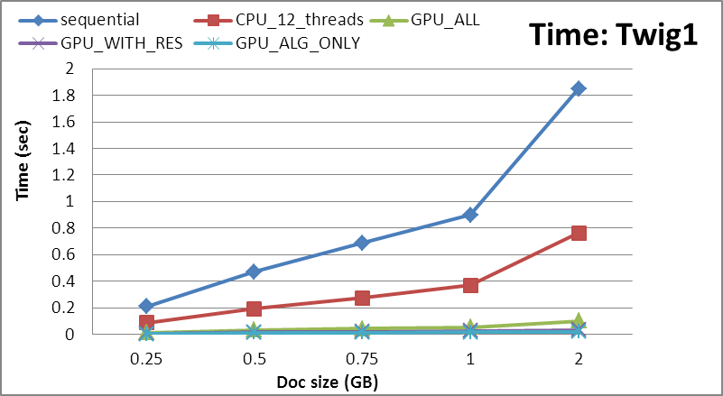
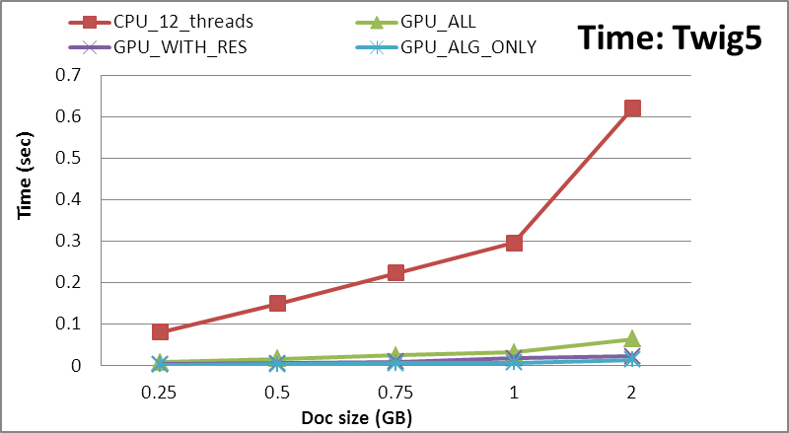
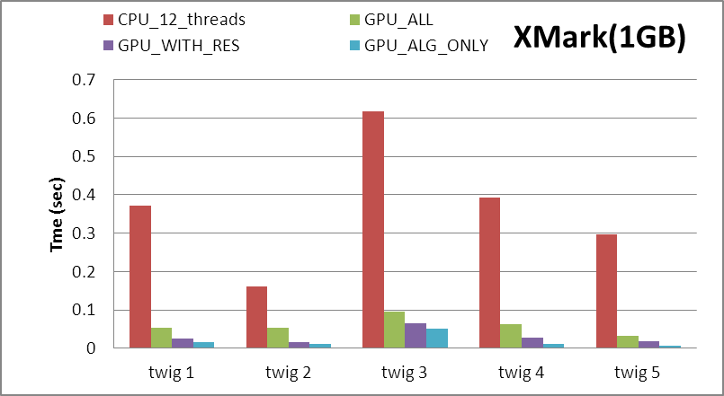
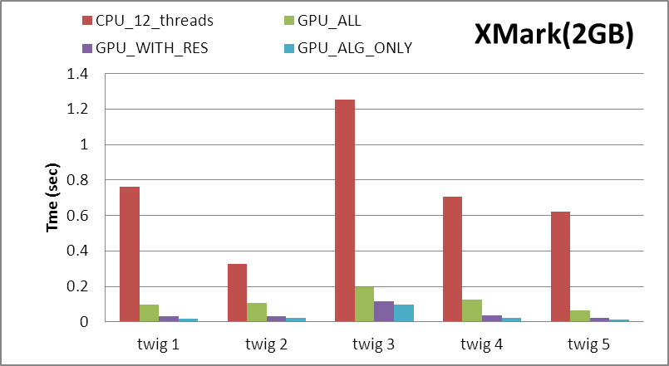
Experiments
14/16

Slide 15
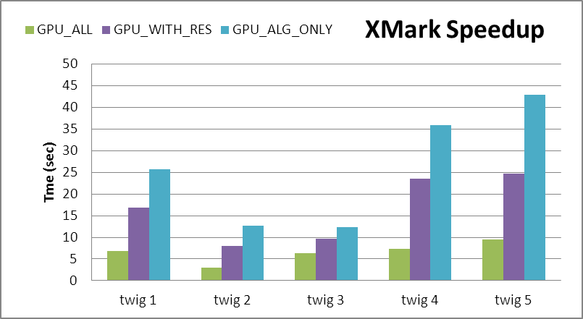
Experiments
15/16

Slide 16
Thank You! Questions?
16/16

