Slide 1
Efficient Locking Techniques for Databases on Modern Hardware
Hideaki Kimura#*
Goetz Graefe⁺
Harumi Kuno⁺
#Brown University
*Microsoft Jim Gray
Systems Lab
⁺Hewlett-Packard Laboratories
at ADMS'12
Slides/papers available on request. Email us:
hkimura@cs.brown.edu, goetz.graefe@hp.com, harumi.kuno@hp.com

Slide 2
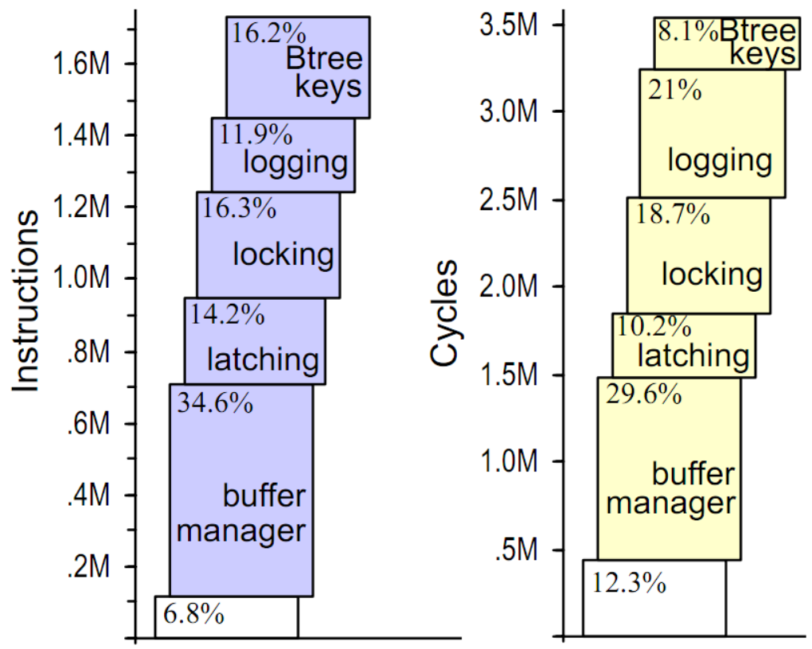
Traditional DBMS on Modern Hardware
Optimized for Magnetic Disk Bottleneck
Disk I/O
Costs
Query Execution Overhead
Other Costs
Then
What’s
This?
Useful Work
Fig. Instructions and Cycles for New Order
[S. Harizopoulos et al. SIGMOD‘08]

Slide 3
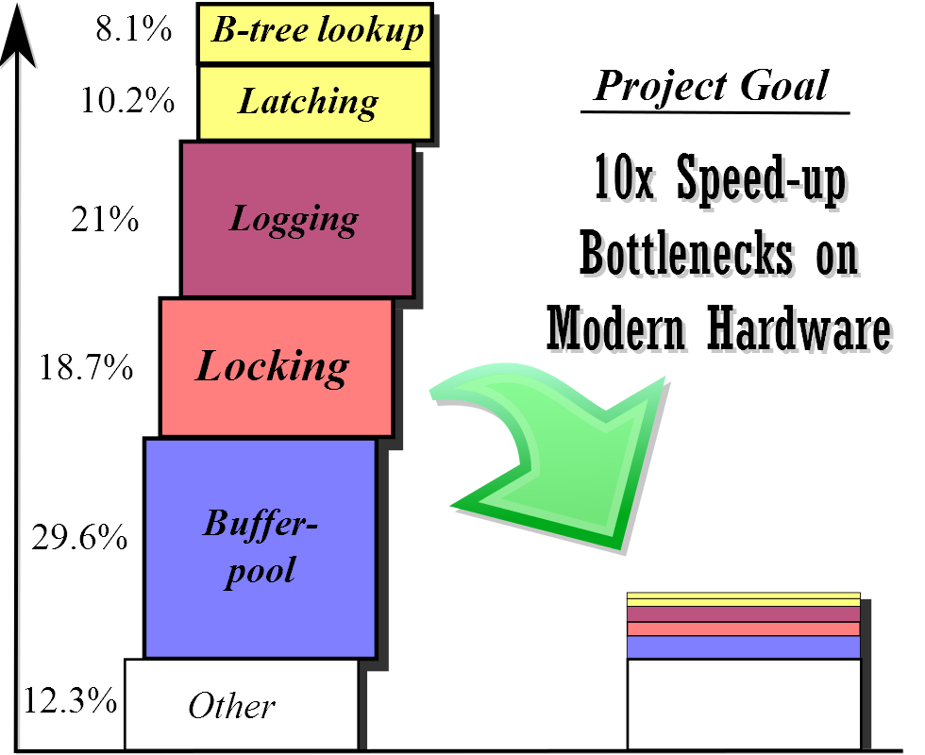
Context of This Paper
Achieved up to 6x overall speed-up
Foster B-trees
Consolidation Array, Flush-Pipeline
Shore-MT/Aether [Johnson et al'10]
This Paper
Work in progress

Slide 4
Our Prior Work: Foster B-trees
[TODS'12]
Foster Relationship
Fence Keys
Simple Prefix Compression
Poor-man's Normalized Keys
Efficient yet Exhaustive Verification
Implemented by modifying Shore-MT and compared with it:
Low Latch Contention | High Latch Contention
2-3x speed-up | 6x speedup
On Sun Niagara. Tested without locks. only latches.

Slide 5
Talk Overview
Key Range Locks w/ Higher Concurrency
Combines fence-keys and Graefe lock modes
Lightweight Intent Lock
Extremely Scalable and Fast
Scalable Deadlock Detection
Dreadlocks Algorithm applied to Databases
Serializable Early-Lock-Release
Serializable all-kinds ELR that allows read-only transaction to bypass logging

Slide 6
1. Key Range Lock
SELECT Key=10
UPDATE Key=30
S
Gap
X
10
20
30
SELECT Key=15
SELECT Key=20~25
Mohan et al. : Locks neighboring key.
Lomet et al.: Adds a few new lock modes. (e.g., RangeX-S)
Still lacks a few lock modes, resulting in lower concurrency.

Slide 7
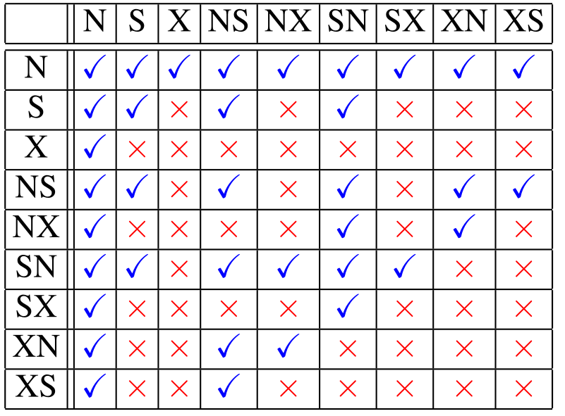
Our Key Range Locking
Graefe Lock Modes. All 3*3=9 modes
Fence Keys
E
F
EA
EB
…
EZ
D
E
Use Fence Keys to lock on page boundary
Create a ghost record (pseudo deleted record) before insertion as a separate Xct.

Slide 8
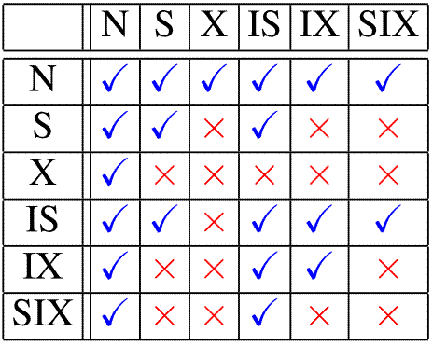
2. Intent Lock
Coarse level locking (e.g., table, database)
Intent Lock (IS/IX) and Absolute Lock (X/S/SIX)
Saves overhead for large scan/write transactions
[Gray et al]
(just one absolute lock)

Slide 9

Intent Lock: Physical Contention
Logical
Physical
Lock Queues
DB-1
IS
IX
DB-1
IS
IX
VOL-1
IS
IX
VOL-1
IS
IX
IND-1
IND-1
IS
IX
IS
IX
Key-A
S
S
Key-A
Key-B
X
Key-B
X

Slide 10
Lightweight Intent Lock
Logical
Physical
DB-1
IS
IX
 | IS | IX | S | X
DB1 | 1 | 1 | 0 | 0
VOL1 | 1 | 1 | 0 | 0
IND1 | 1 | 1 | 0 | 0
Counters
for
Coarse
Locks
VOL-1
IS
IX
IND-1
No Lock Queue, No Mutex
IS
IX
Key-A
S
Lock
Queues
for Key
Locks
Key-A
S
Key-B
X
Key-B
X

Slide 11
Intent Lock: Summary
Extremely Lightweight for Scalability
  Just a set of counters, no queue
  Only spinlock. Mutex only when absolute lock is requested.
  Timeout to avoid deadlock
Separate from main lock table
 | Main Lock Table | Intent Lock Table
Physical Contention | Low | High
Required Functionality | High | Low

Slide 12
3. Deadlock Handling
Traditional approaches have some drawback
Deadlock Prevention (e.g., wound-wait/wait-die) can cause many false positives
Deadlock Detection (Cycle Detection)
  Infrequent check: delay
  Frequent/Immediate check: not scalable on many cores
Timeout: false positives, delays, hard to configure.

Slide 13
Solution: Dreadlocks
[Koskinen et al '08]
Immediate deadlock detection
Local Spin: Scalable and Low-overhead
Almost* no false positives (*)due to Bloom filter
More details in paper
  Issues specific to databases:
    Lock modes, queues and upgrades
    Avoid pure spinning to save CPU cycles
    Deadlock resolution for flush pipeline

Slide 14
4. Early Lock Release
[DeWitt et al'84]
[Johnson et al'10]
Resources
Transactions
A
B
C
T1
Lock
T1:S
T1:S
T3:X
T2
Commit Request
T2:X
T3:S
Locks
T3
S: Read
X: Write
T4
Flush
Wait
Commit
Protocol
T5
10ms-
Unlock
…
More and More
Locks, Waits, Deadlocks
Group-Commit
Flush-Pipeline
T1000

Slide 15
Prior Work: Aether
[Johnson et al VLDB'10]
First implementation of ELR in DBMS
Significant speed-up (10x) on many-core
Simply releases locks on commit-request
LSN
Serial Log
"… [must hold] until both their own and their predecessor’s log records have reached the disk. Serial log implementations preserve this property naturally,…"
10
T1: Write
11
T1: Commit
Dependent
ELR
12
T2: Commit
Problem: A read-only transaction
bypasses logging
Notes:
… Databases have Serially written log, in which each log has sequential number, LSN. In this log, T1, the predecessor writes commit log first and does ELR. then T2 commits after that. And, the log flusher flushes logs to disk in this order. So, it doesn't violate serializability… Is it true? <clk>

Slide 16
Anomaly of Prior ELR Technique
Lock-queue: "D"
D=20
Event | Latest LSN | Durable LSN
T2: D=20 | 1 | 0
(T1: Read D) | 2 | 0
T2: Commit-Req | 3 | 0
T1: Read D | 4 | 0
T1: Commit | 5 | 1
… | .. | 2
T2: Commit | .. | 3
D=10
✓
Rollback T2
T2:X
✓
T1:S
D is 20!
Crash!
T1

Slide 17
Naïve Solutions
Flush wait for Read-Only Transaction
Orders of magnitude higher latency.
    Short read-only query: microseconds
    Disk Flush: milliseconds
Do not release X-locks in ELR (S-ELR)
Concurrency as low as No-ELR
After all, all lock-waits involve X-locks

Slide 18
Safe SX-ELR: X-Release Tag
Lock-queue: "D"
D=20
Event | Latest LSN | Durable LSN
T2: D=20 | 1 | 0
(T1: Read D) | 2 | 0
T2: Commit-Req | 3 | 0
T1: Read D (max-tag=3) | 4 | 0
T1: Commit-Req | 5 | 1
T3: Read E (max-tag=0) & Commit | 6 | 2
T1, T2: Commit | 7 | 3
D=10
✓
T2:X
tag
✓
T1:S
3
0
max-tag
T1
Lock-queue: "E"
E=5
✓
T3:S
tag
E is 5
0
T3

Slide 19
Safe SX-ELR: Summary
Serializable yet Highly Concurrent
Safely release all kinds of locks
Most read-only transaction quickly exits
Only necessary threads get waited
Low Overhead
Just LSN comparison
Applicable to Coarse Locks
Self-tag and Descendant-tag
SIX/IX: Update Descendant-tag. X: Upd. Self-tag
IS/IX: Check Self-tag. S/X/SIX: Check Both

Slide 20
Experiments
TPC-B: 250MB of data, fits in bufferpool
Hardware
  Sun-Niagara: 64 Hardware contexts
  HP Z600: 6 Cores. SSD drive
Software
  Foster B-trees (Modified) in Shore-MT (Original) with/without each technique
  Fully ACID, Serializable mode.

Slide 21
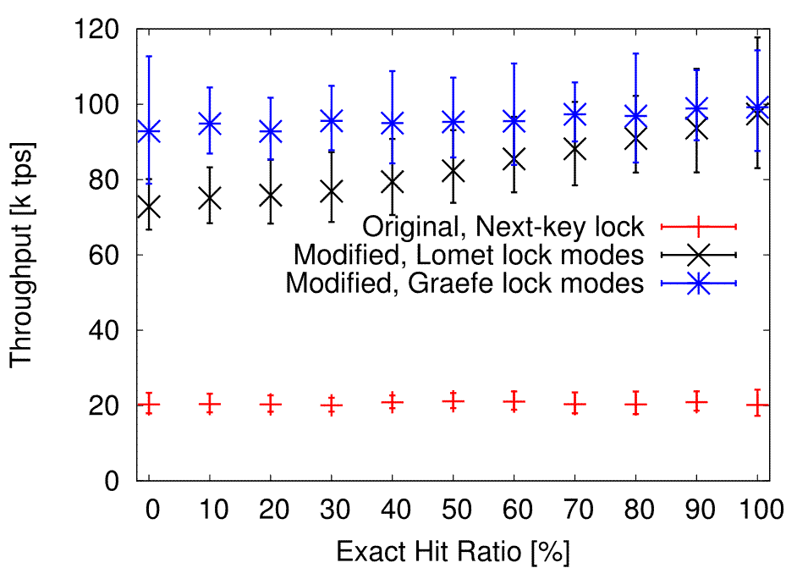
Key Range Locks
Z600, 6-Threads,
AVG & 95% on 20 Runs
Notes:
Ran a series of range query and update. Some of range queries exactly hits existing keys, so key range lock mode doesn't matter. Other range queries don't hit existing keys, so we take range locks.

Slide 22
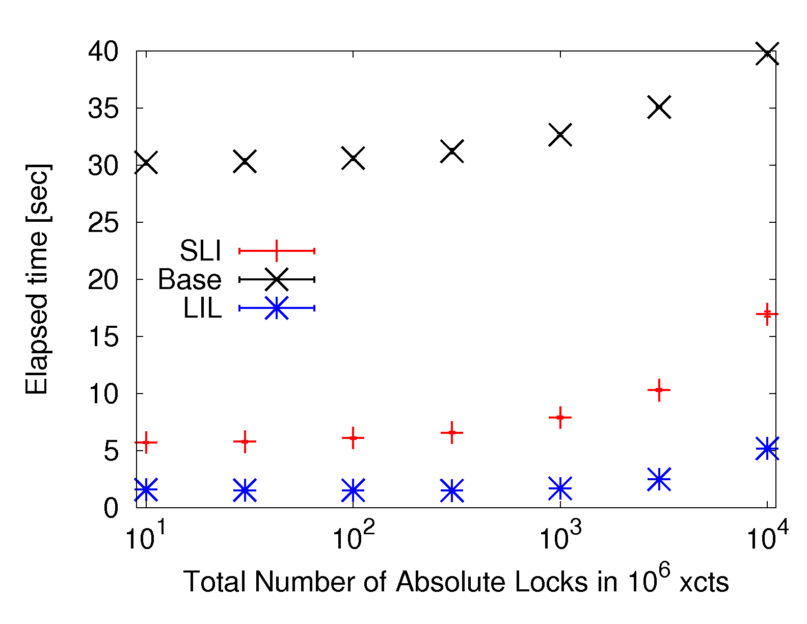
Lightweight Intent Lock
Sun Niagara, 60 threads,
AVG & 95% on 20 Runs
Notes:
Measured overhead of taking and releasing intent locks.

Slide 23
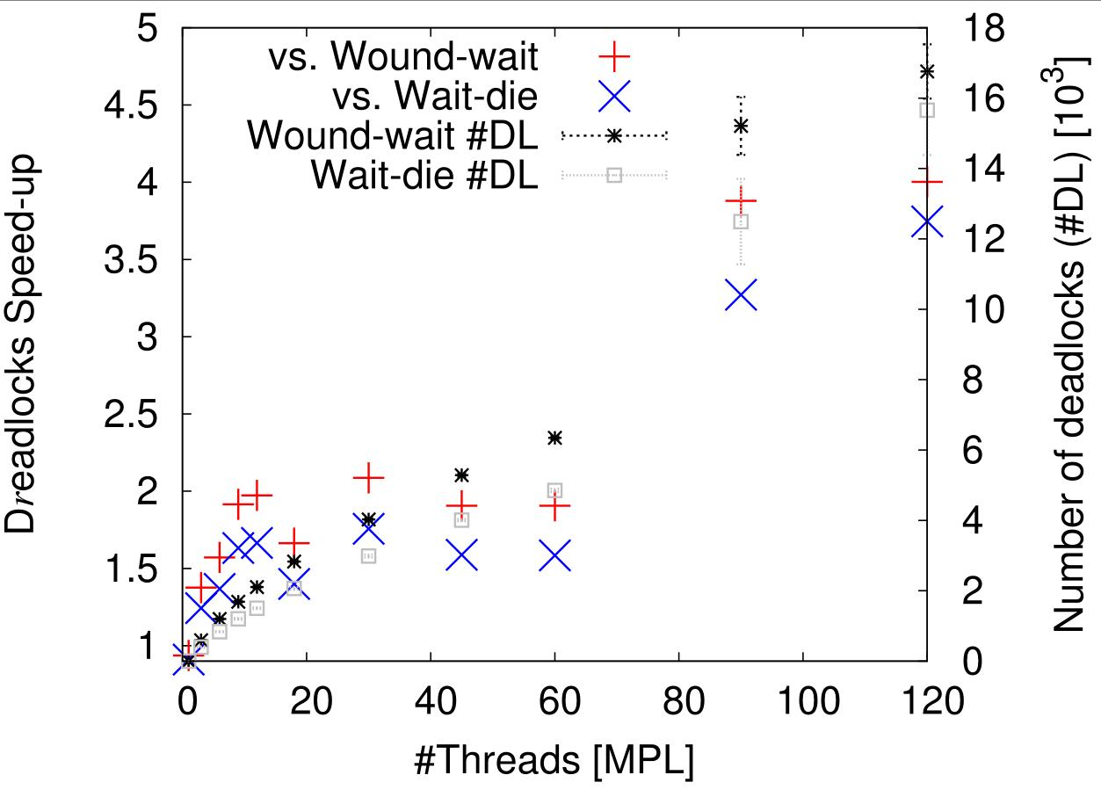
Dreadlocks vs Traditional
Sun Niagara,
AVG on 20 Runs
Notes:
Next, we compared our implementation of Dreadlocks with traditional methods, namely wound-wait and wait-die. In this experiment, there is no true deadlock. So, all of the deadlocks raised by traditional methods are false positives. And the number of such false deadlocks quickly goes up with the number of threads. In contrast, Dreadlocks raise almost no false positives thus acheieve up to 3 to 4 times better throughput.

Slide 24
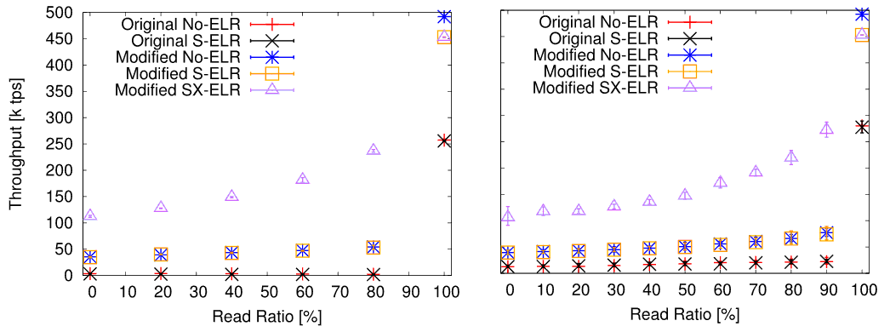
Early Lock Release (ELR)
Z600, 6-Threads,
AVG & 95% on 20 Runs
HDD Log
SSD Log
SX-ELR performs 5x faster.
S-only ELR isn’t useful
All improvements combined, -50x faster.

Slide 25
Related Work
ARIES/KVL, IM [Mohan et al]
Key range locking [Lomet'93]
Shore-MT at EPFL/CMU/UW-Madison
Speculative Lock Inheritance [Johnson et al'09]
Aether [Johnson et al'10]
Dreadlocks [Koskinen and Herlihy'08]
H-Store at Brown/MIT

Slide 26
Wrap up
Locking as bottleneck on Modern H/W
Revisited all aspects of database locking
  Graefe Lock Modes
  Lightweight Intent Lock
  Dreadlock
  Early Lock Release
All together, significant speed-up (-50x)
Future Work: Buffer-pool

Slide 28
Reserved: Locking Details

Slide 29

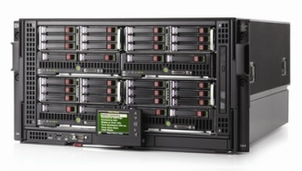
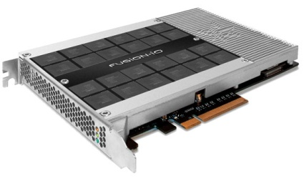
Transactional Processing
High Concurrency
Very Short Latency
Fully ACID-compliant
Relatively Small Data
# Digital Transactions
CPU
Clock Speed
Modern Hardware

Slide 30
Many-Cores and Contentions
Logical Contention
Physical Contention
Mutex or
Spinlock
Shared Resource
Critical
Section
0
1
0
1
1
1
0
0
Doesn't Help,
even Worsens!

Slide 31
Background: Fence keys
A~
A
M
V
~Z
Define key ranges in each page.
A~
~M
A
C
E
A~
~C
C~
~E
~B
B~
~C

Slide 32
Key-Range Lock Mode [Lomet '93]
Adds a few new lock modes
Consists of 2 parts; Range and Key
RangeX-S
RangeI-N
S
I
(*) Instant
X lock
X
*
10
20
30
RangeS-S
S (RangeN-S)
But, still lacks a few lock modes

Slide 33
Example: Missing lock modes
SELECT Key=15
RangeS-N?
RangeS-S
10
20
30
X
UPDATE Key=20
RangeA-B

Slide 34
Graefe Lock Modes
New lock
modes
*
(*)
S≡SS
X≡XX

Slide 35
(**) Ours locks the key prior to the range while SQL Server uses next-key locking.
Next-key
locking
Prior-key
locking
RangeS-N ≈ NS

Slide 36
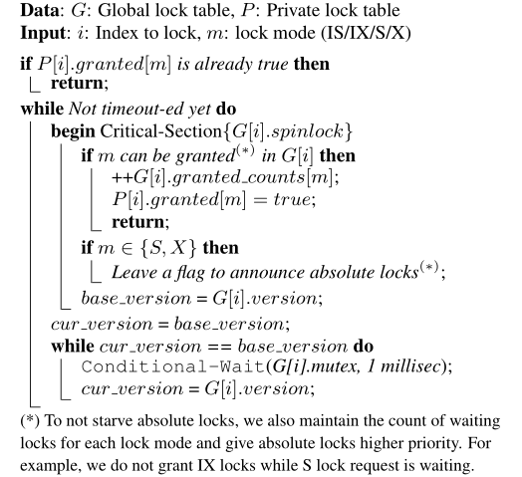
LIL: Lock-Request Protocol

Slide 37
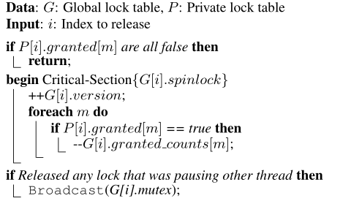
LIL: Lock-Release Protocol

Slide 38
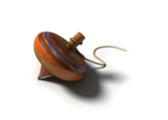
Dreadlocks [Koskinen et al '08]
A waits for B (live lock)
C
D
A
B
(dead lock)
E
Thread
1. does it contain me?
A
B
C
E
D
deadlock!!
Digest*
{A}
{B}
{C}
{A,B}
{C,D}
{E}
{D}
{E,C}
{E,C,D}
{D,E}
D
2. add it to myself
(*) actually a Bloom filter (bit-vector).
Notes:
invented by Koskinen and Herlihy. deadlock detection algorithm geared to many cores.

Slide 39
Naïve Solution: Check Page-LSN?
Page
LSN
Page
Page
0
M
Z
1
Log-buffer
D=10
20
1: T2, D, 10→20
✓
T2
E=5
2: T2, Z, 20→10
3: T2, Commit
T1
immediately exits if durable-LSN≥1?
Read-only transaction can exit only after Commit Log of dependents becomes durable.

Slide 40
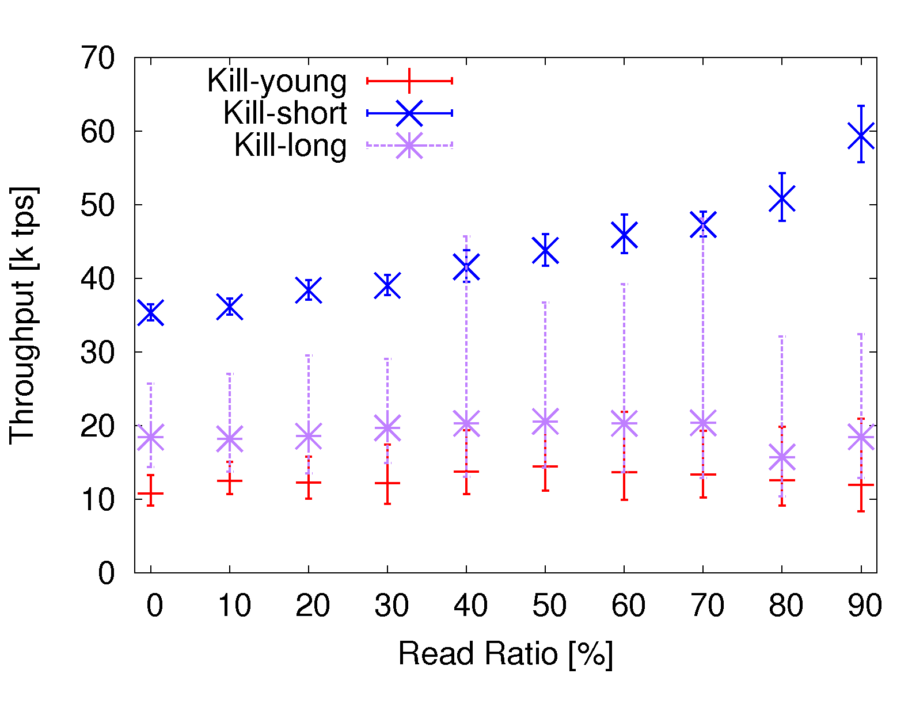
Deadlock Victim & Flush Pipeline

Slide 41
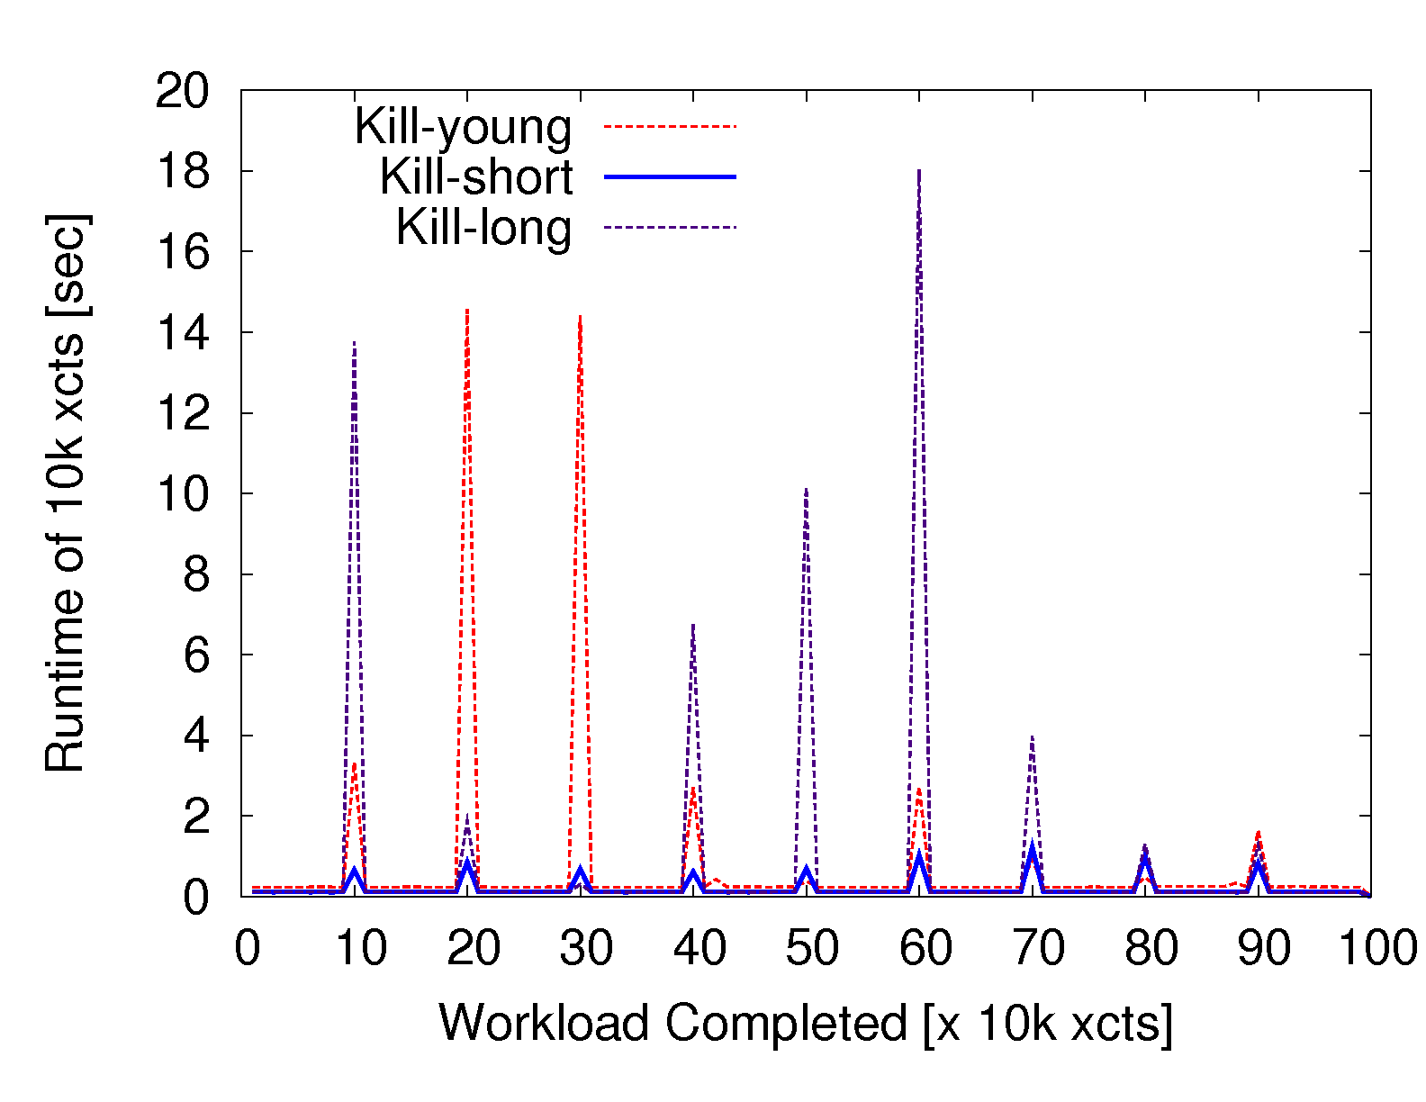
Victim & Flush Pipeline (Cont'd)

Slide 42
Dreadlock + Backoff on Sleep
TPC-B, Lazy commit, SSD, Xct-chain max 100k

Slide 43
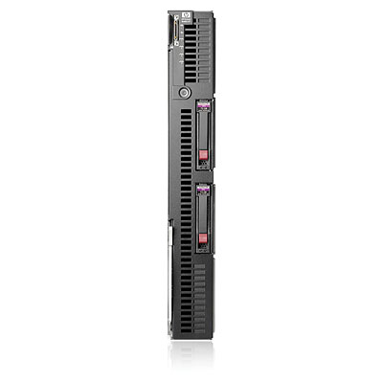
Related Work: H-Store/VoltDB
Differences
Disk-based DB ↔ Pure Main-Memory DB
Shared-everything ↔ -nothing in each node
Foster B-Trees/Shore-MT
VoltDB
(Note: both are
shared-nothing across-nodes)
Distributed Xct
Pros/Cons
Accessible RAM per CPU
Simplicity and Best-case Performance
RAM
RAM
Both are interesting
directions.
Keep 'em, but improve 'em.
Get rid of latches.

Slide 44
Reserved: Foster B-tree Slides

Slide 45

Latch Contention in B-trees
1. Root-leaf EX Latch
2. Next/Prev Pointers

Slide 46


Foster B-trees Architecture
A~
A
M
V
~Z
A~
~M
1. Fence-keys
A
C
E
A~
~C
C~
~E
~B
B~
~C
2. Foster Relationship
cf. B-link tree [Lehman et al‘81]

Slide 47
More on Fence Keys
Slot array
Efficient Prefix Compression
Powerful B-tree Verification
Efficient yet Exhaustive Verification
Simpler and More Scalable B-tree
  No tree-latch
  B-tree code size Halved
Key Range Locking
"I3"
"J1"
High: "AAP"
"AAI31"
"I31"
Poor man's
normalization
Low: "AAF"
"I31", xxx
Tuple

Slide 48
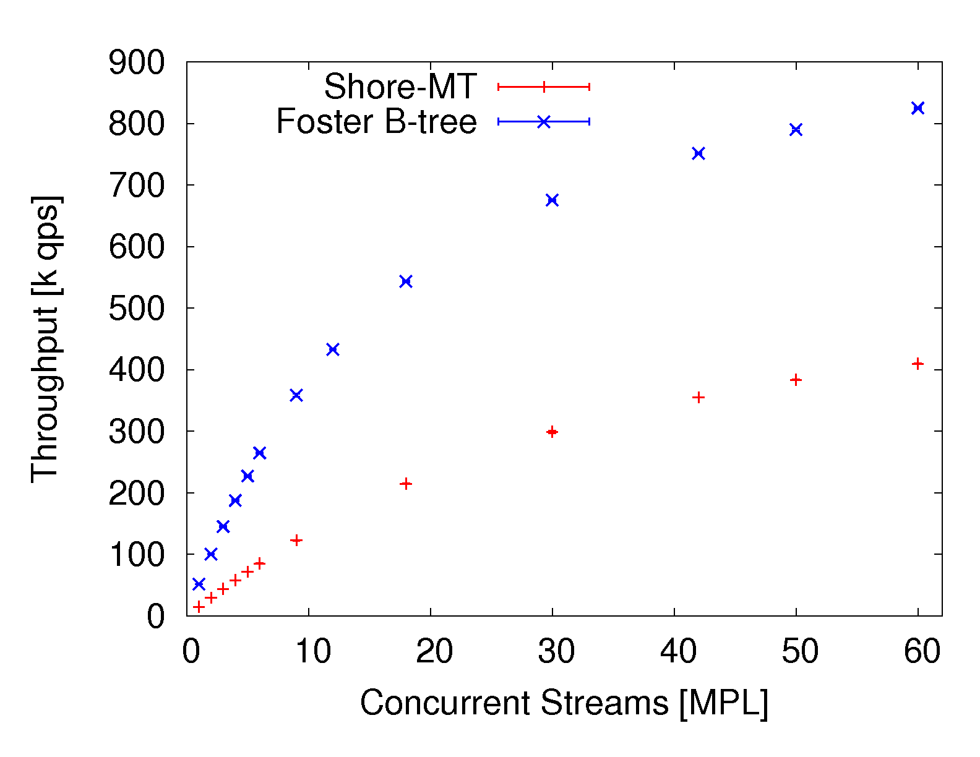
B-tree lookup speed-up
No Locks. SELECT-only workload.

Slide 49
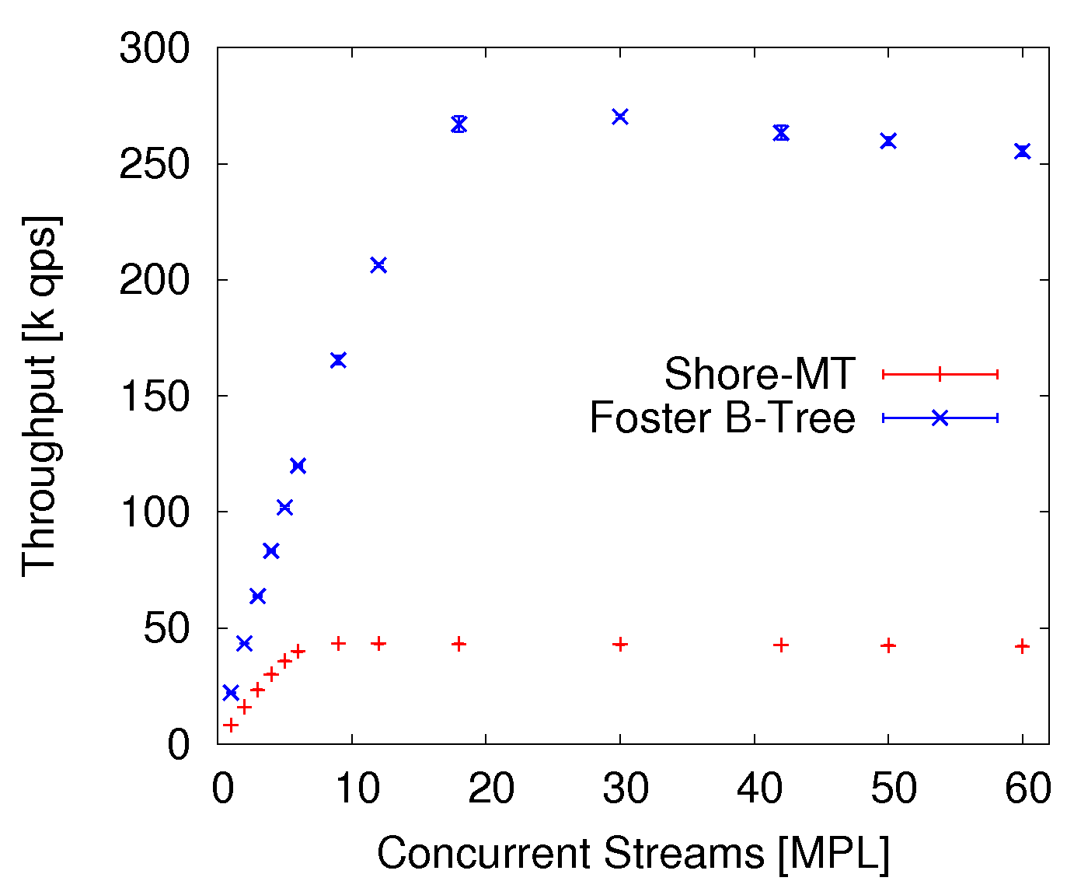
Insert-Intensive Case
Log-Buffer
Contention
Bottleneck
6-7x Speed-up
Will port
"Consolidation
Array"
[Johnson et al]
Latch
Contention
Bottleneck

Slide 50
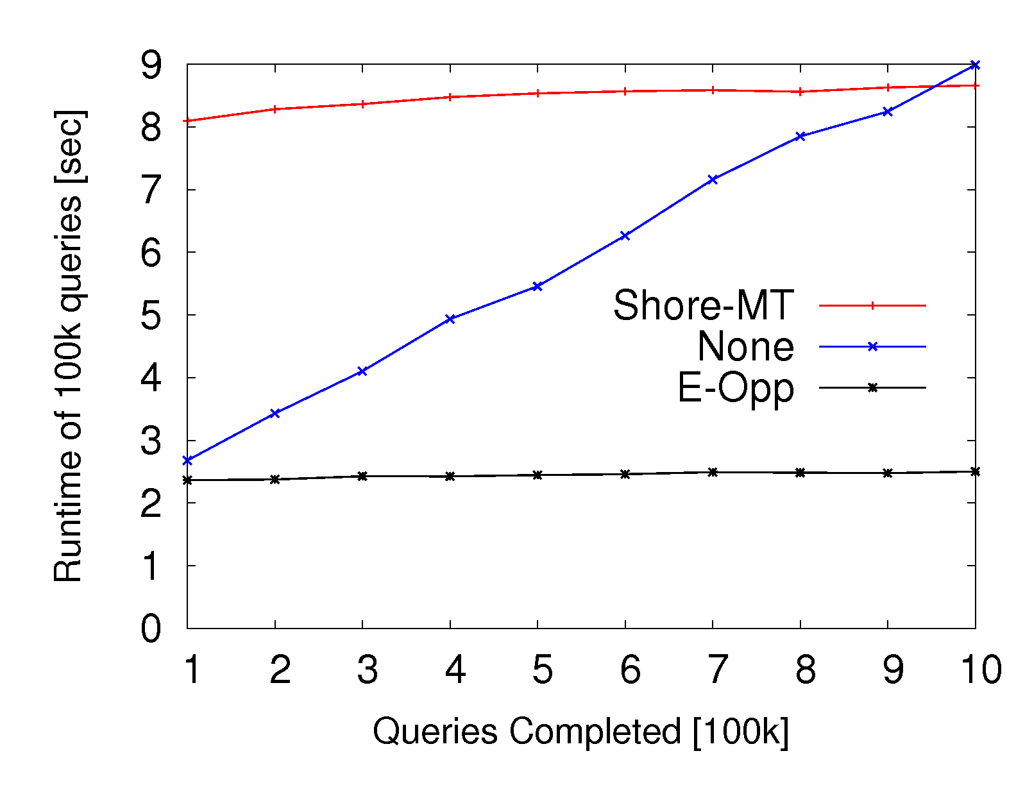
Chain length: Mixed 1 Thread

Slide 51
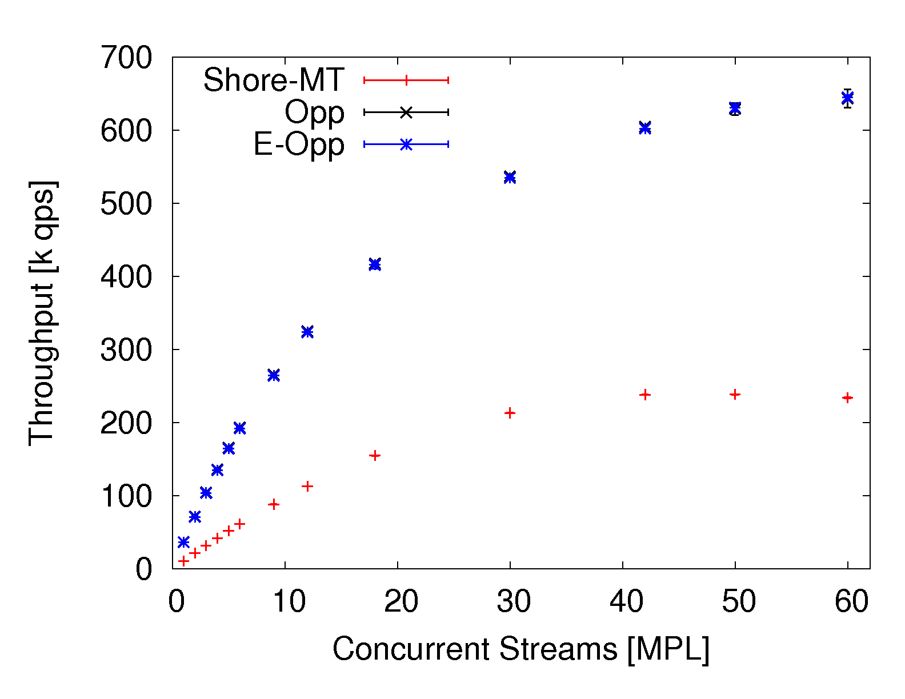
Eager-Opportunistic

Slide 52
B-tree Verification

